Slide 1
KENTS Presentation Artificial Intelligence in Medicine Practical Approaches & Opportunities
Idris Chikophe
Pediatric Cardiac Anesthesiologist
Critical Care Practitioner
AI Hobbyist
AKUHN

Slide 2
Agenda
Introduction, definitions & historical perspectives
Current state of AI
Applications in Healthcare
Academia
Research
Bedside
Management
Dark side of AI
Bias
Data quality
Data shift
Model shift
Black box effect
Ethical/ Legal
Who is calpbale when AI is wrong

Slide 3
Introduction to AI
What is AI?
Ability of computers to perform tasks that usually require human intelligence
Such as the ability to examine an X-ray image and identify areas consistent with pathology (fractures)

Slide 4
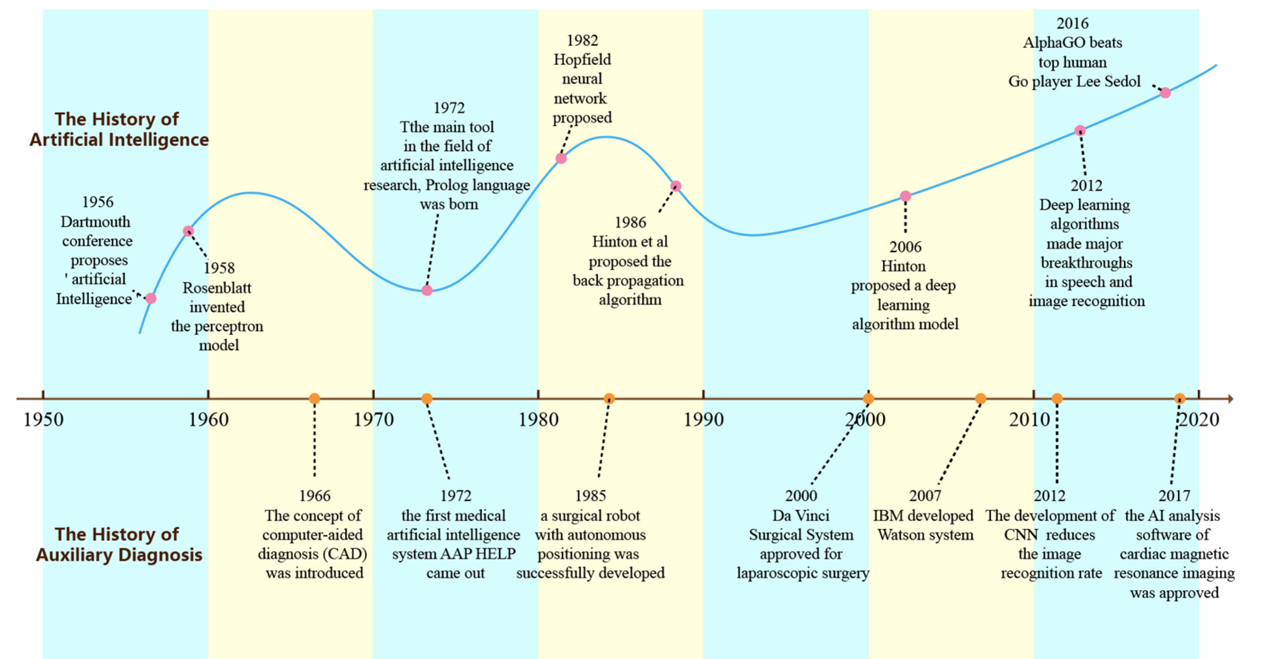
Historical Perspcetives

Slide 5
Machine Learning
Subset of AI
Statistical learning algorithms to interpret and learn from data to predict future events
No explicit programming required
Traditional ML
Predefined features of interest e.g. shape, size,heterogeneity of tumor, etc., derived by some mathematical or statistical functionn.
Fewer data points needed
Modern ML (Neural Networks)
Automatically determine which features are important
Multiple decision nodes (neurons) stacked in mathematical layers with non-linear activation functions
Inspired by biological neurones
Data hungry

Slide 6
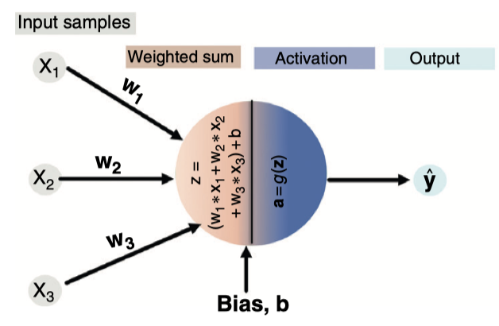
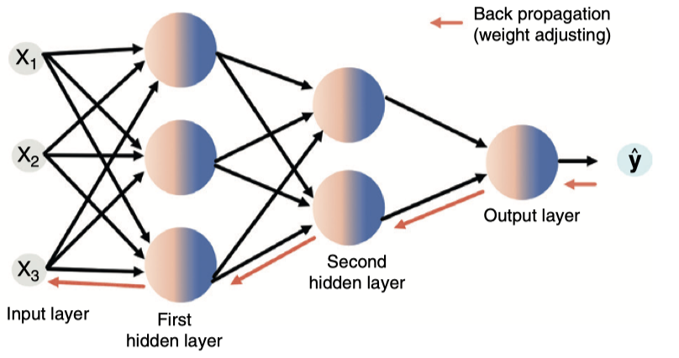
Neural Networks

Slide 7
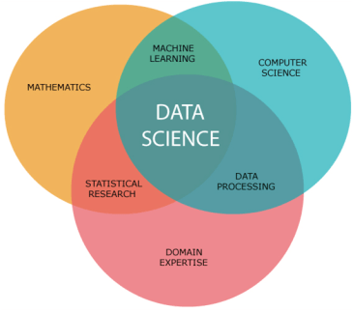
Data Science

Slide 8
Strategies to Train Algorithms
Supervised learning
Dependent and indepent variables
Samples of X-ray images with labels (pneuonia: class 1) and no pneumonia (class 0) for training
Used to classify new X-ray image as either 0 or 1
Semi-supervised learning
Some samples are labelled
Unsupervised learning
Training data have no labels
Model learns without explicit instructions
E.g. clustering
Reinforcement learning
Reward and penalty scheme that makes the system learn

Slide 9
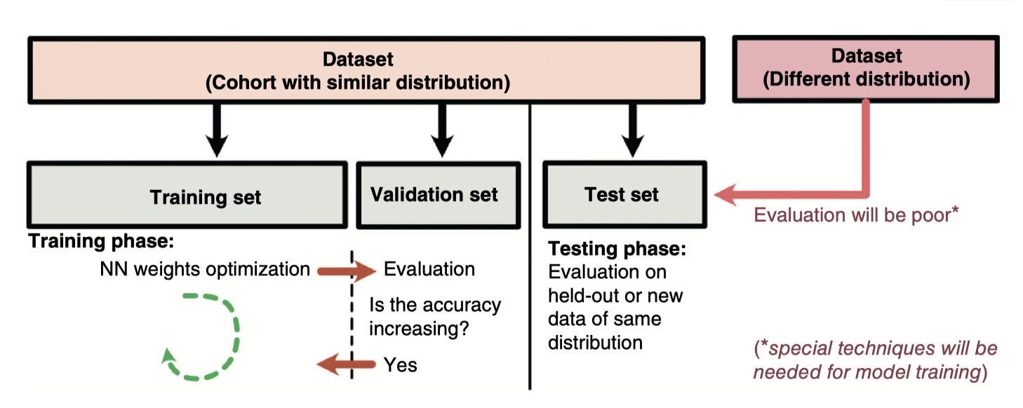
Data Preparation

Slide 10
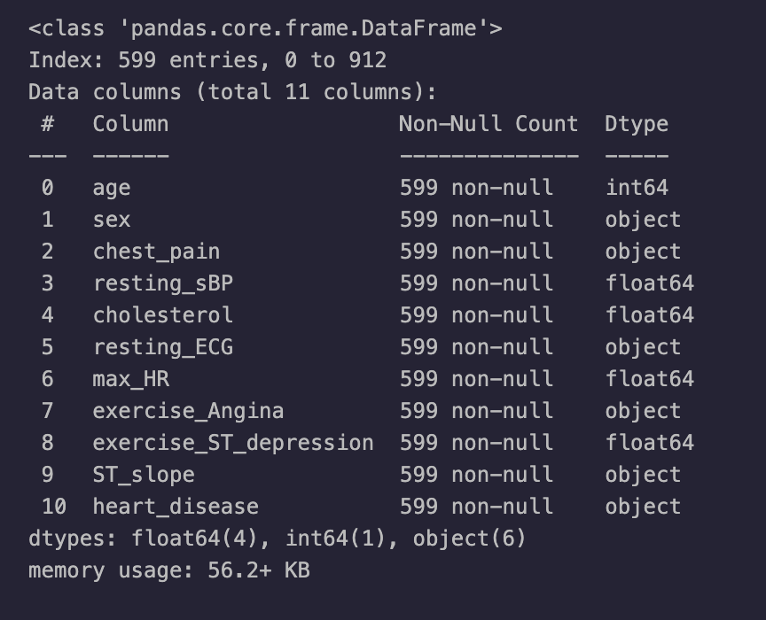
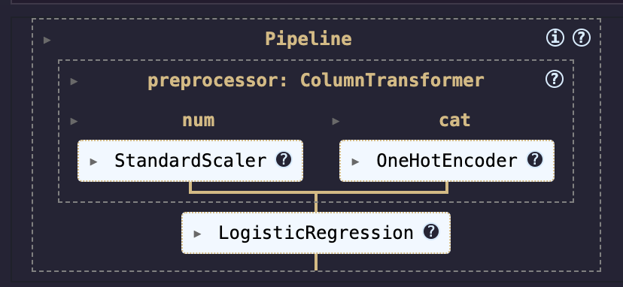
Supervised Learning

Slide 11
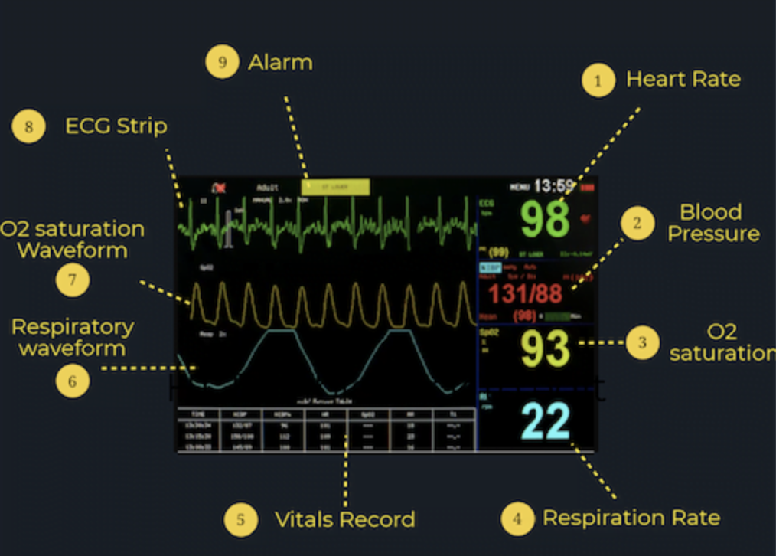
Variables

Slide 12
Variables: Structured Data
Numerical: scalar(number) , vectors (lists)
Complex numerical (time series)
Heart rate every 5 minutes?
Categorical: ordinal, nominal

Slide 13
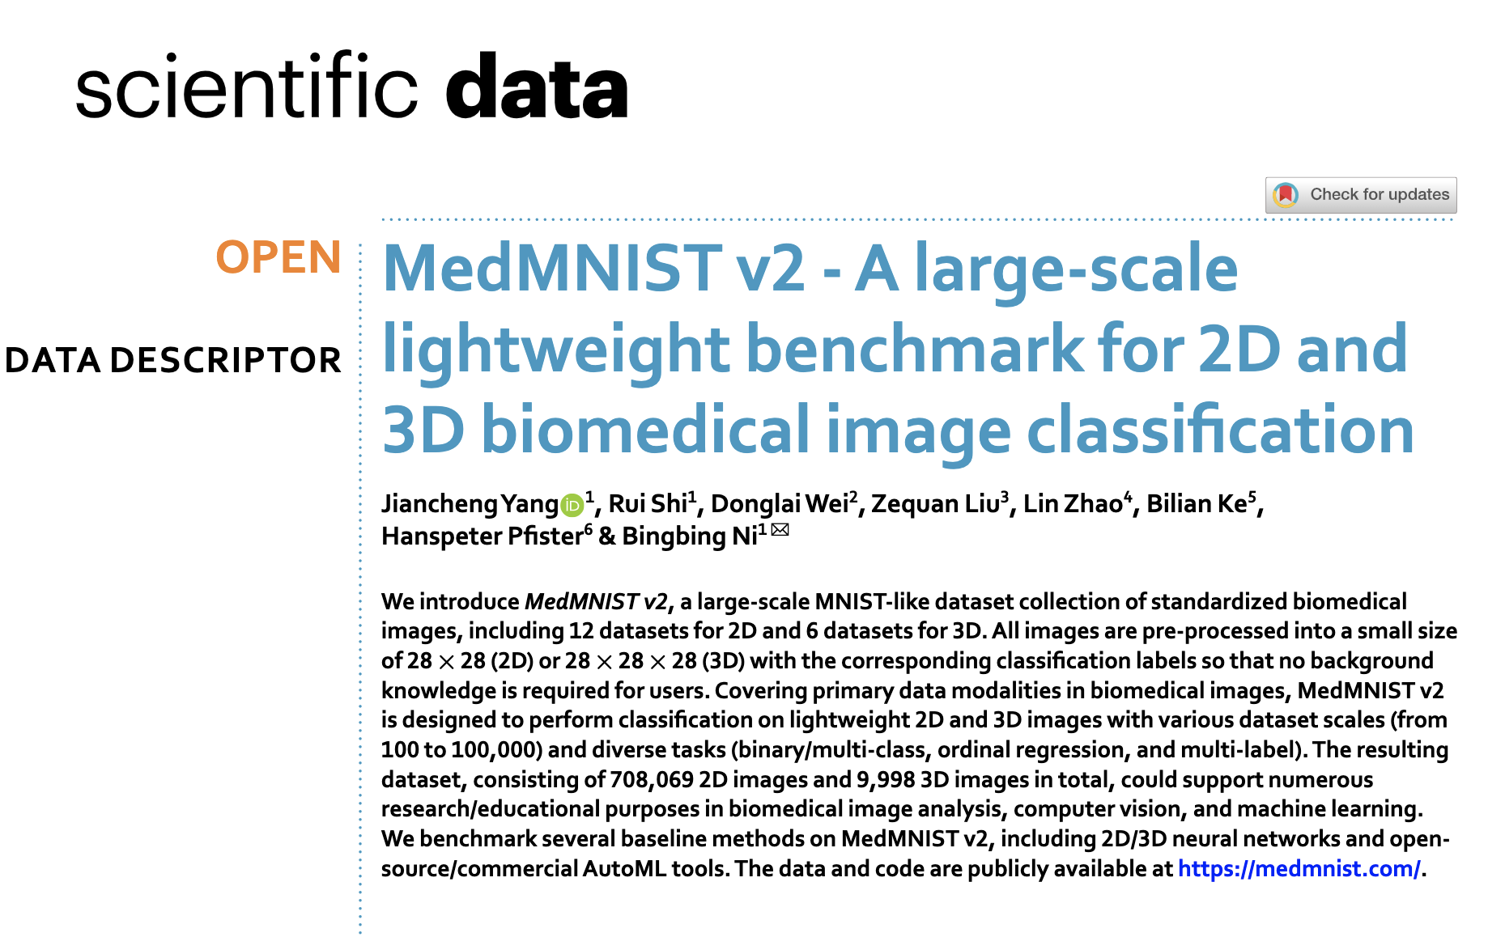
Variables: Unstructured Data

Slide 14
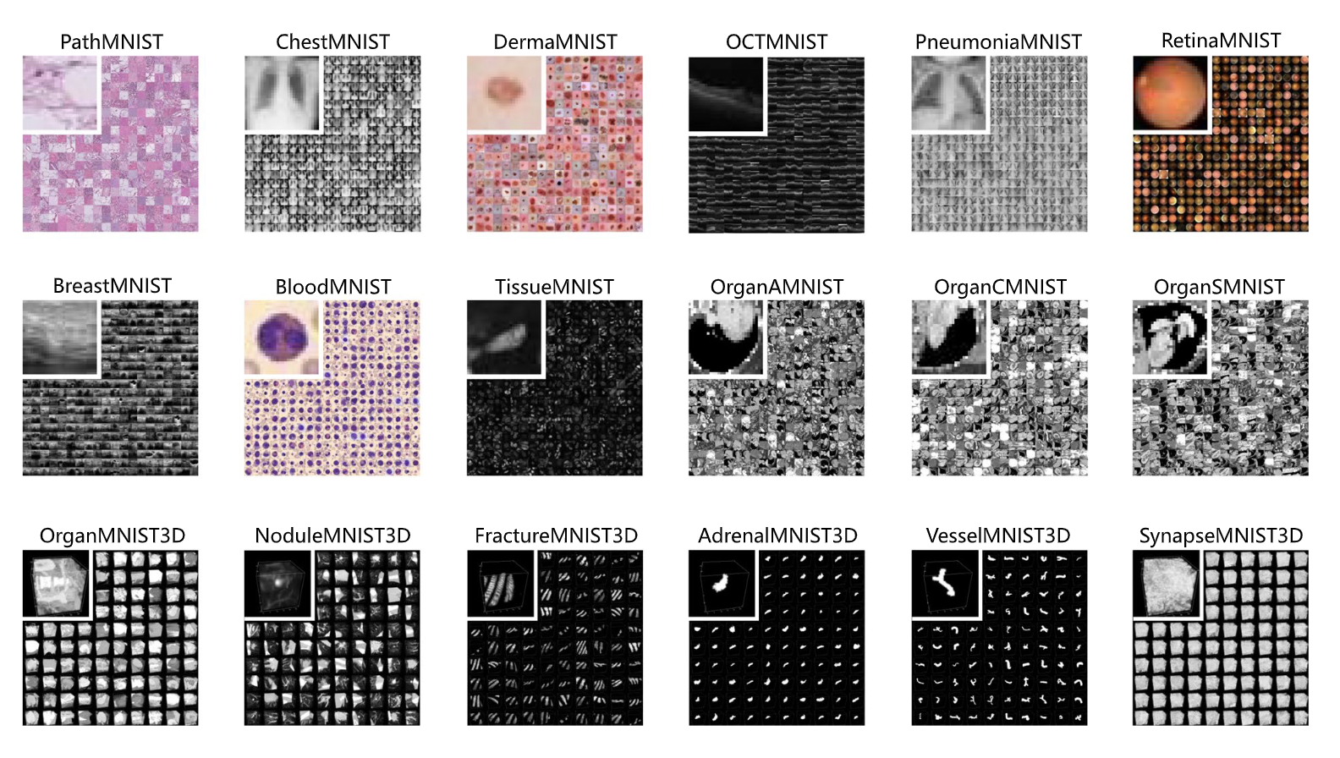

Slide 15
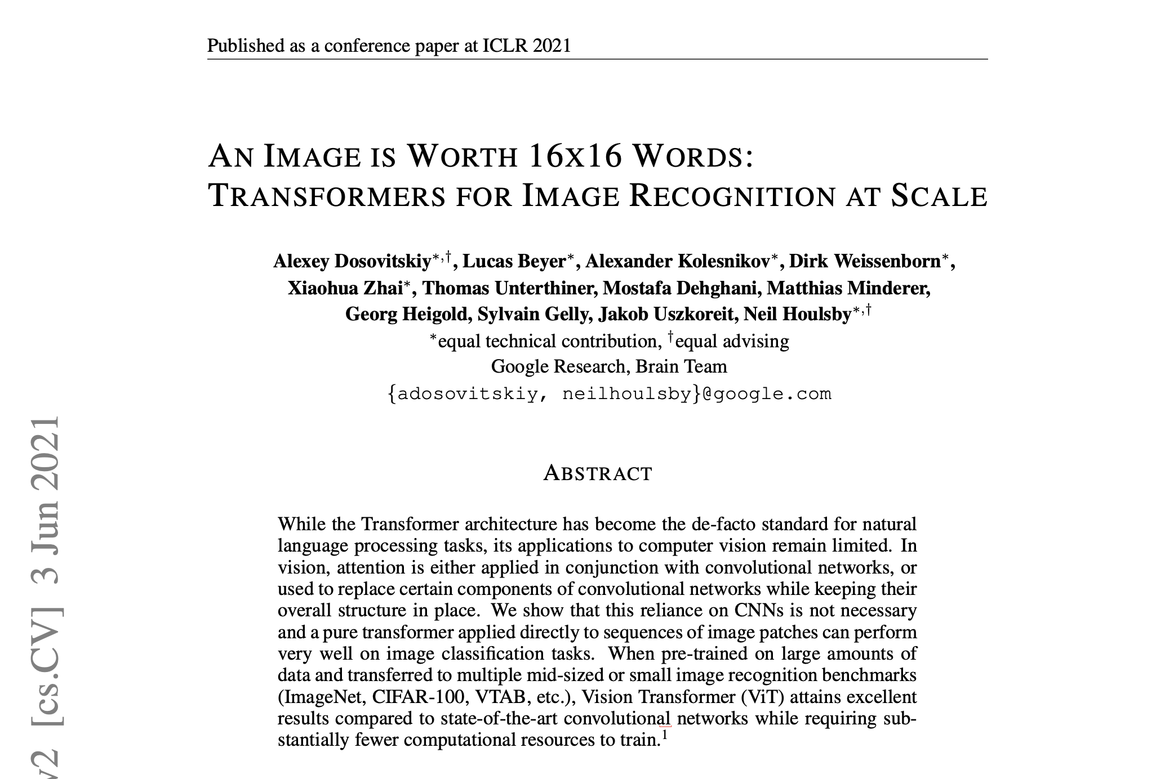
Current State of AI

Slide 16
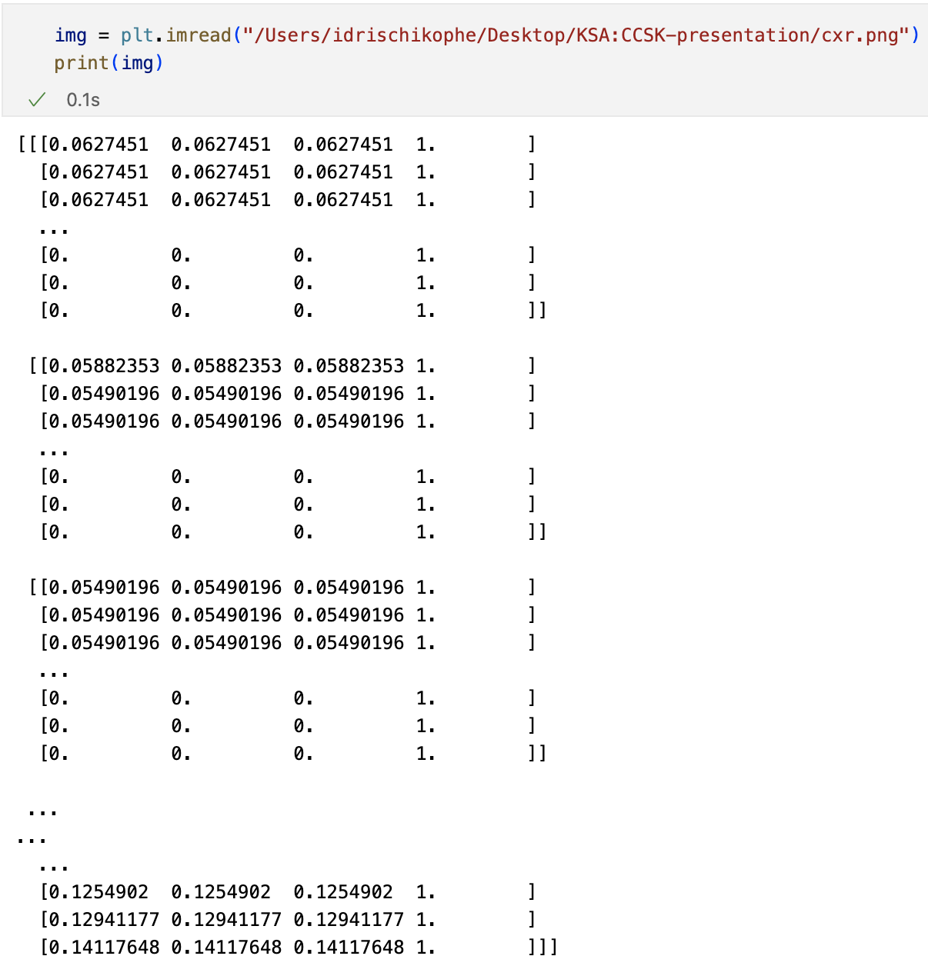
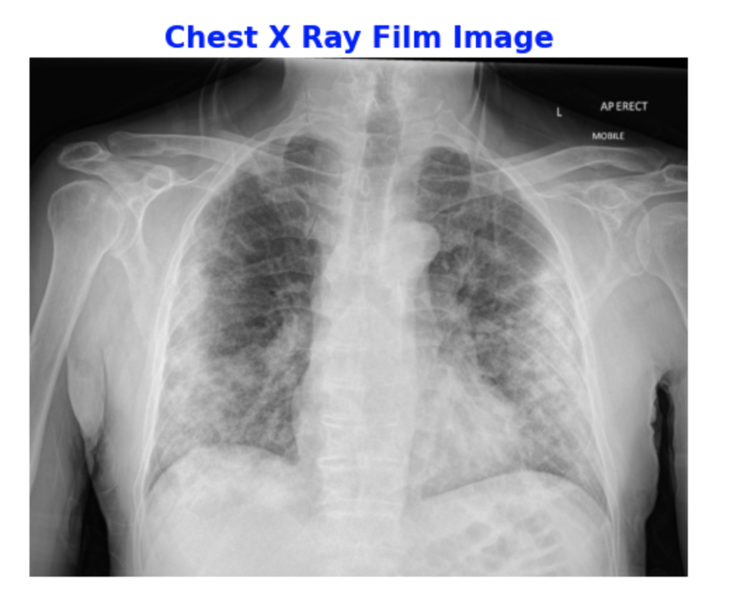
Variables:Unstructured Data (Images)

Slide 17
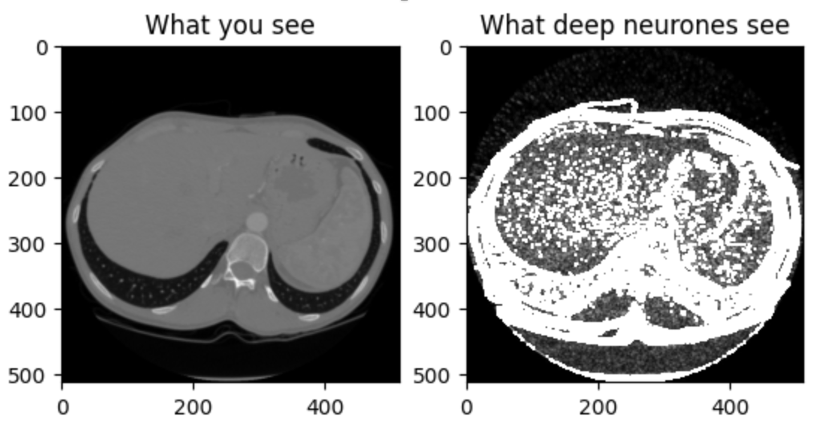
Feature Extraction: Convolutions

Slide 18
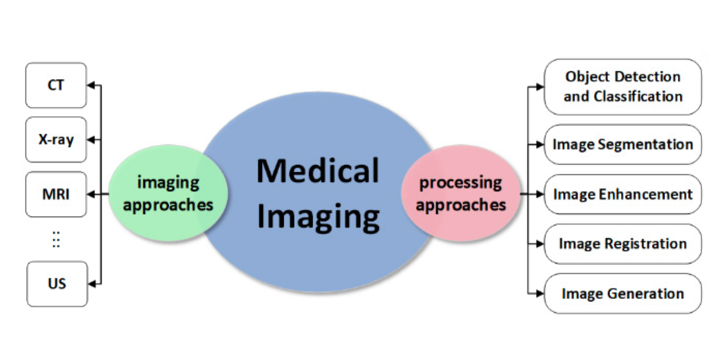

Slide 19
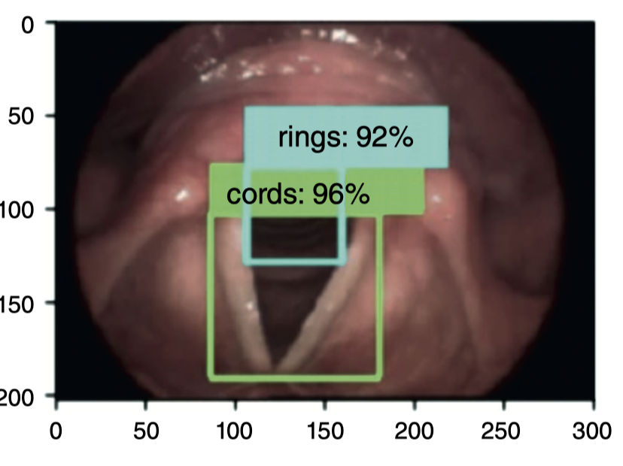

Slide 20
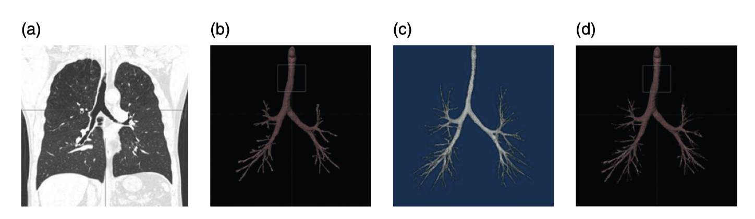

Slide 21
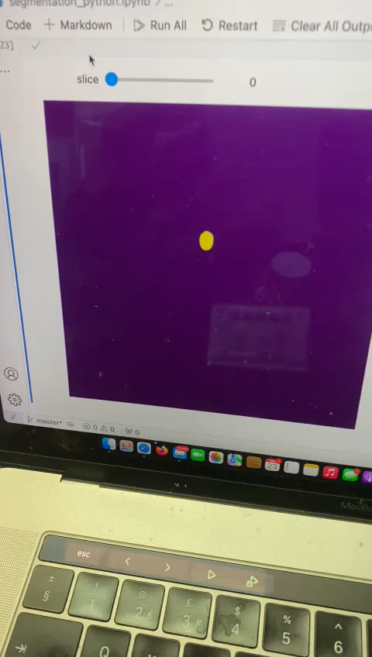

Slide 22
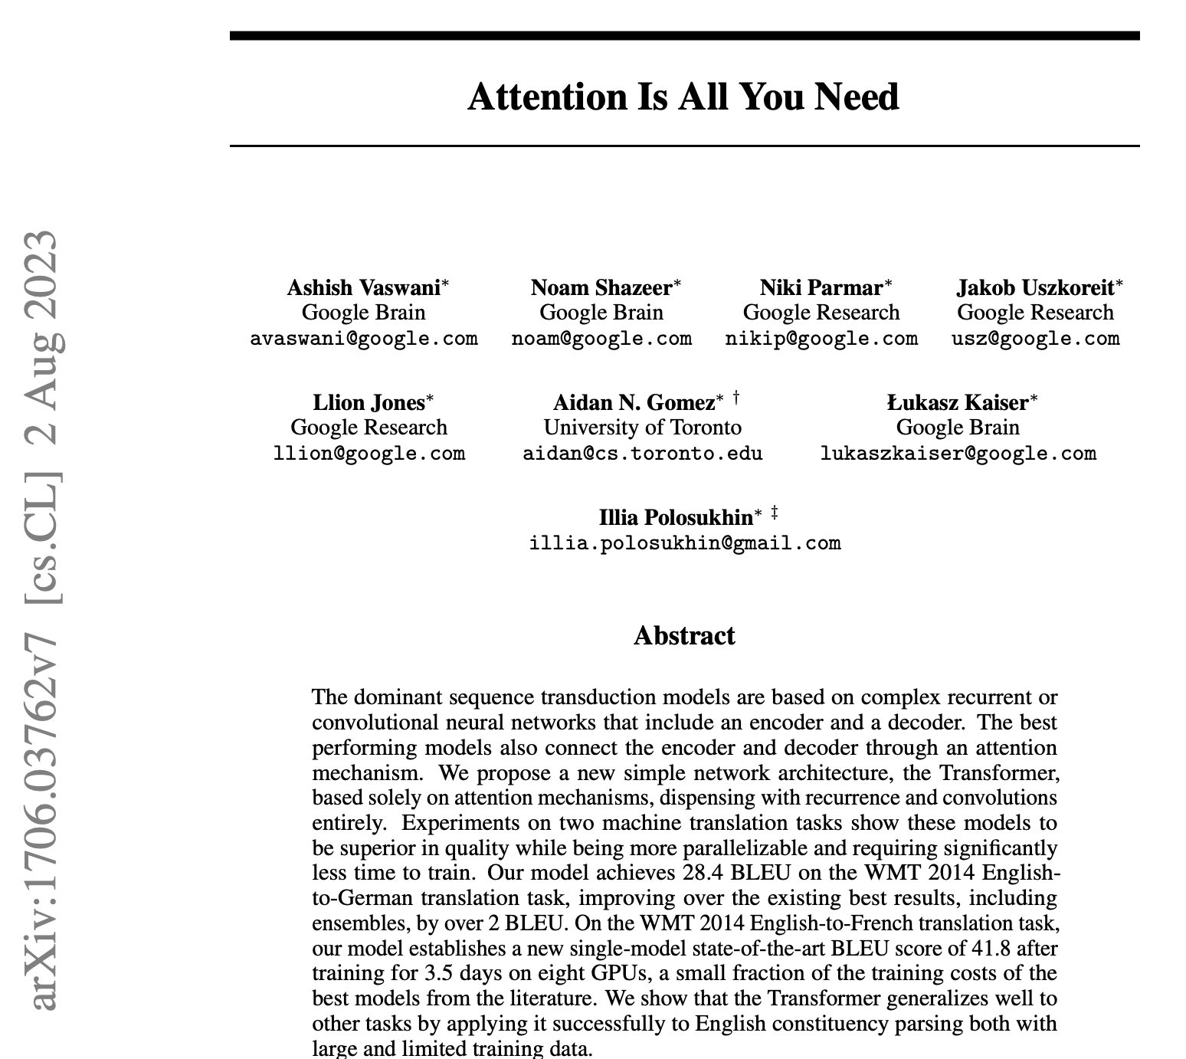
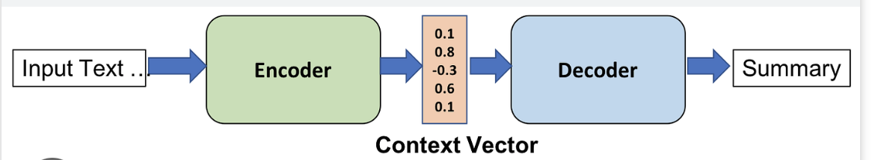
Current State of AI

Slide 23
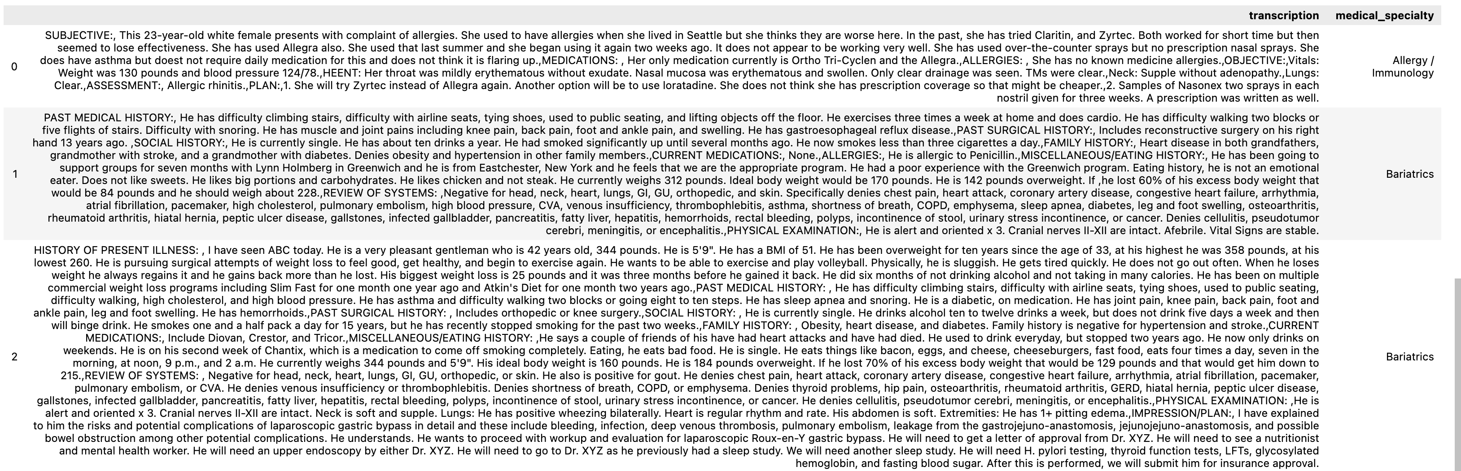
Variables:Unstructured Data (Text)

Slide 24
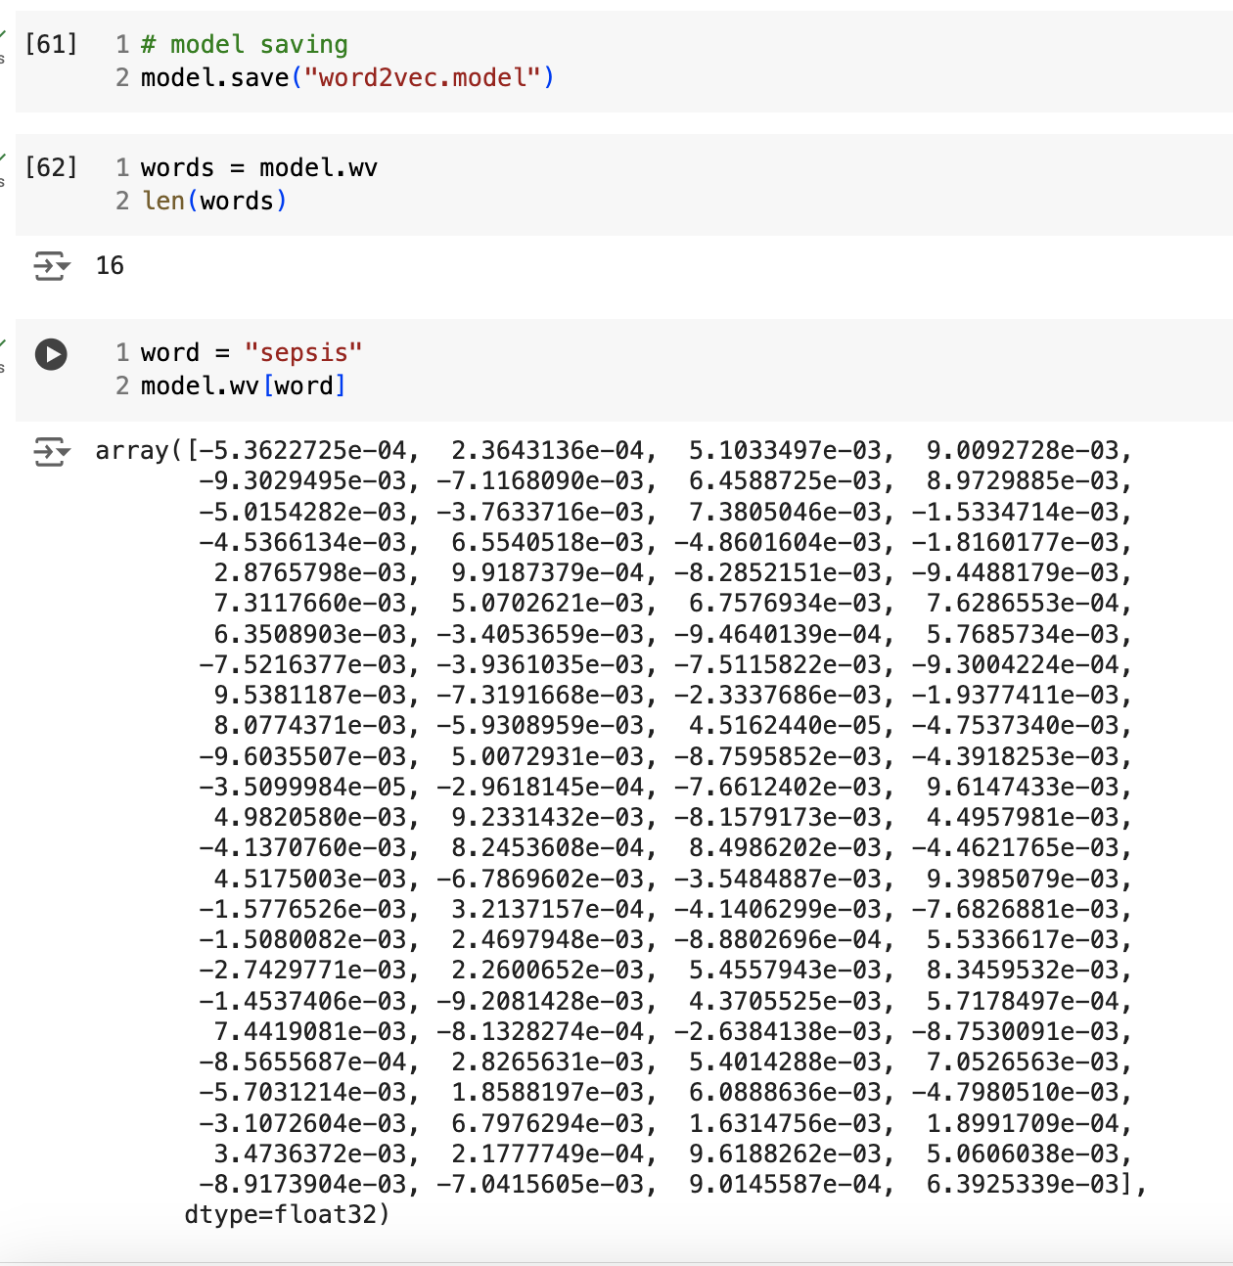
Current State of AI: Vectorization

Slide 25
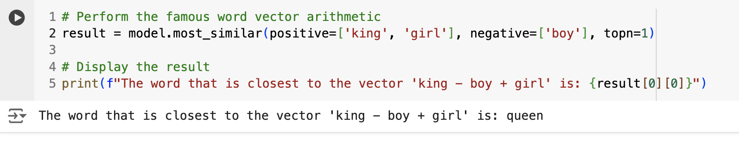
Current State of AI: Vector Mathematics

Slide 26
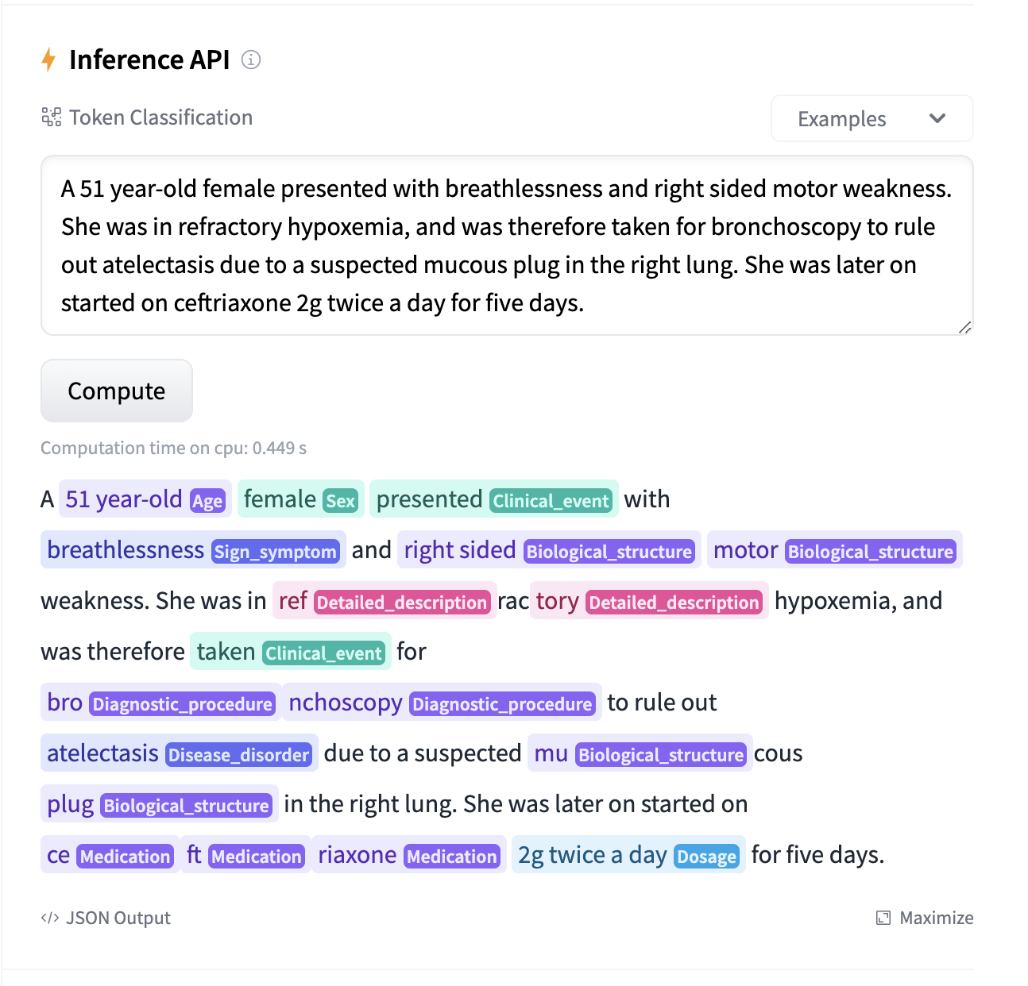
NLU: Named Entity Recognition

Slide 27
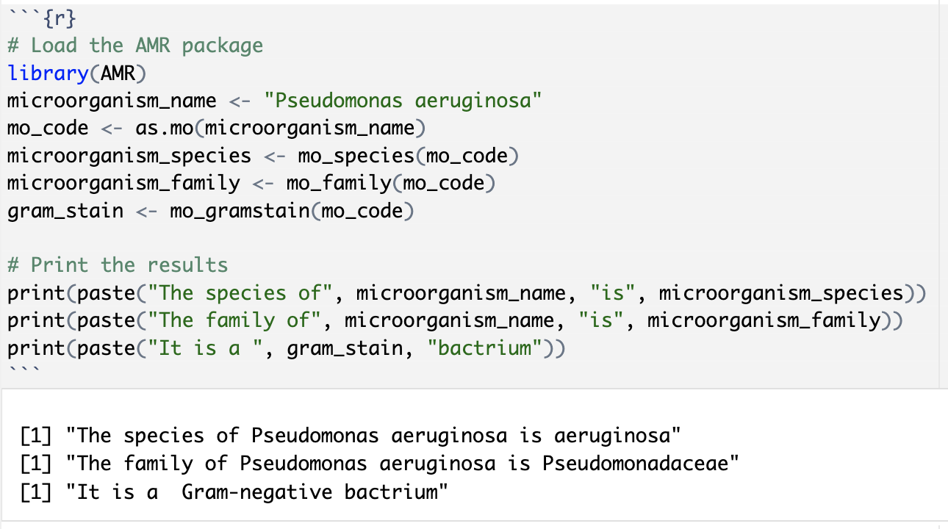
Medical NLU

Slide 28
Application: Academia

Slide 29
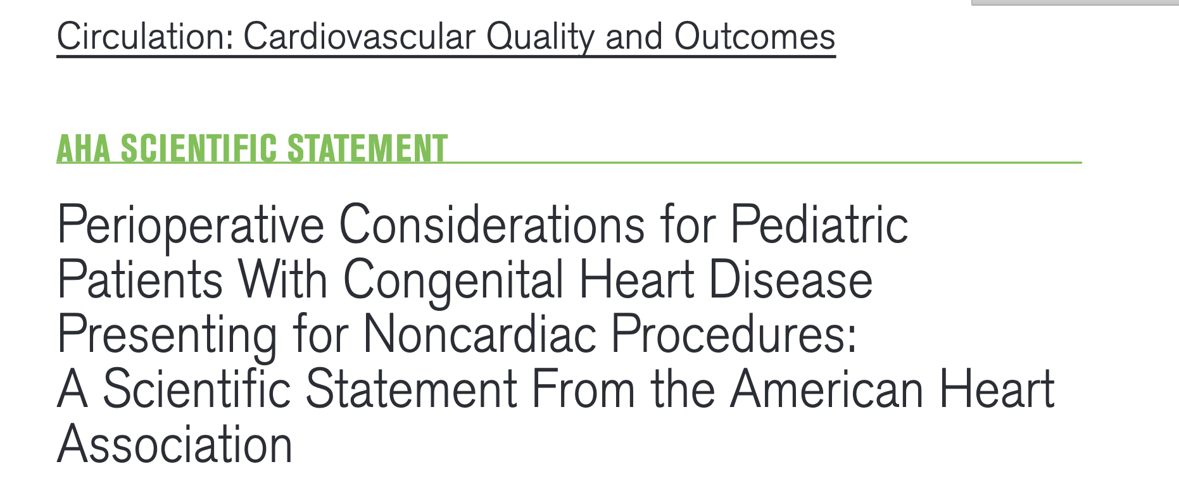
AI in Academia Reference Librarian (RAG)

Slide 30
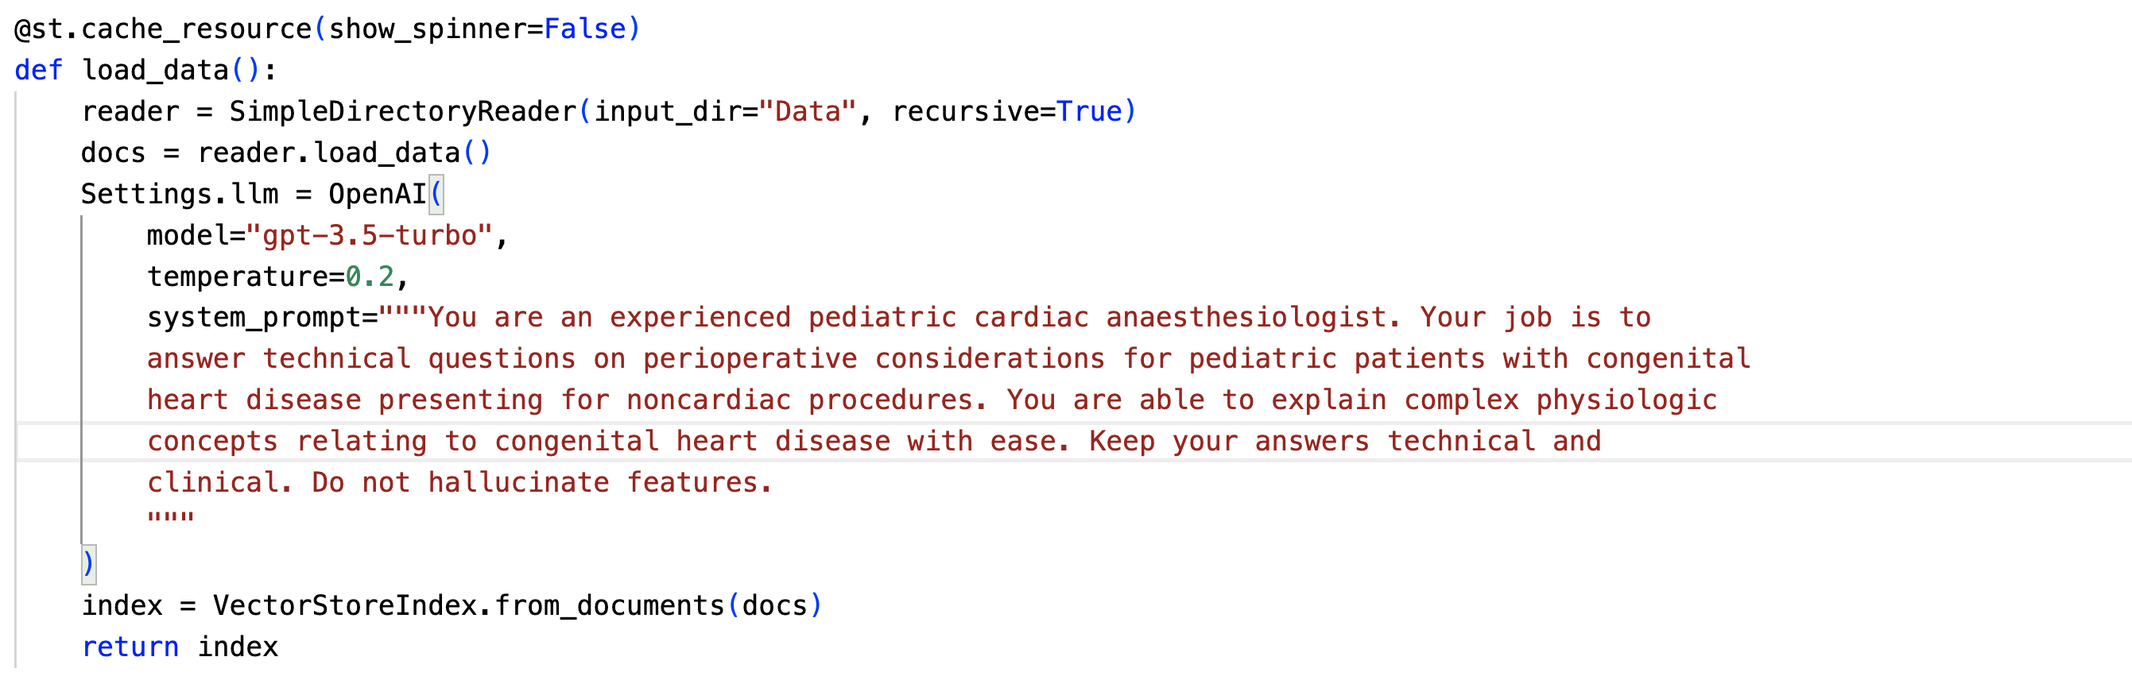
AI in Academia Reference Librarian (RAG)

Slide 31
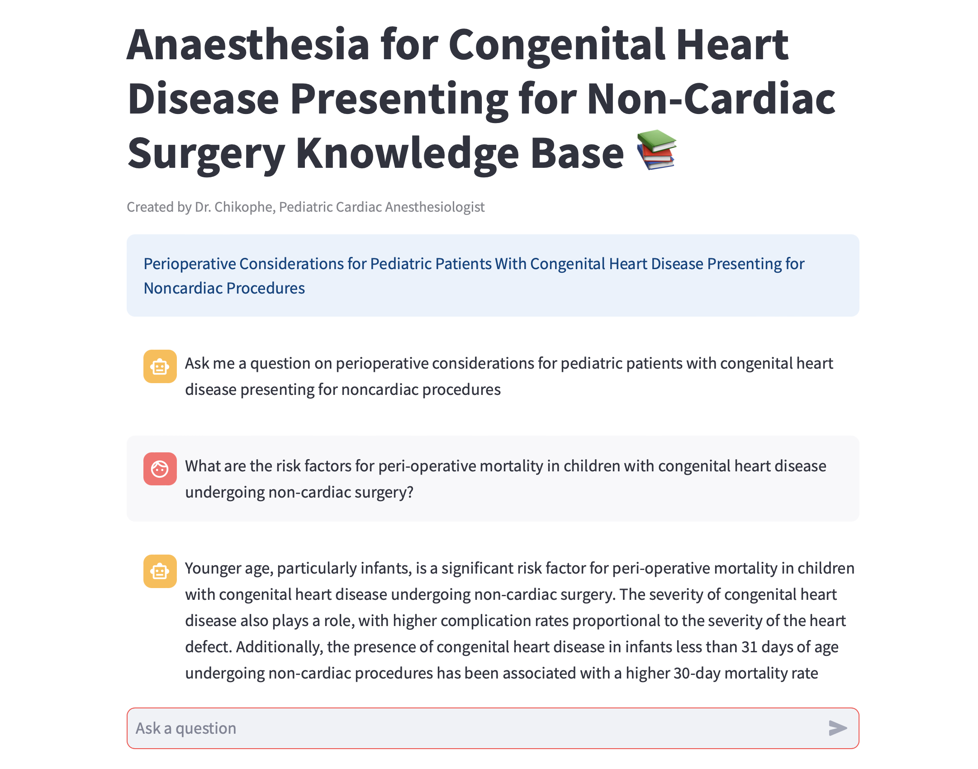
AI in Academia Reference Librarian (RAG)

Slide 32
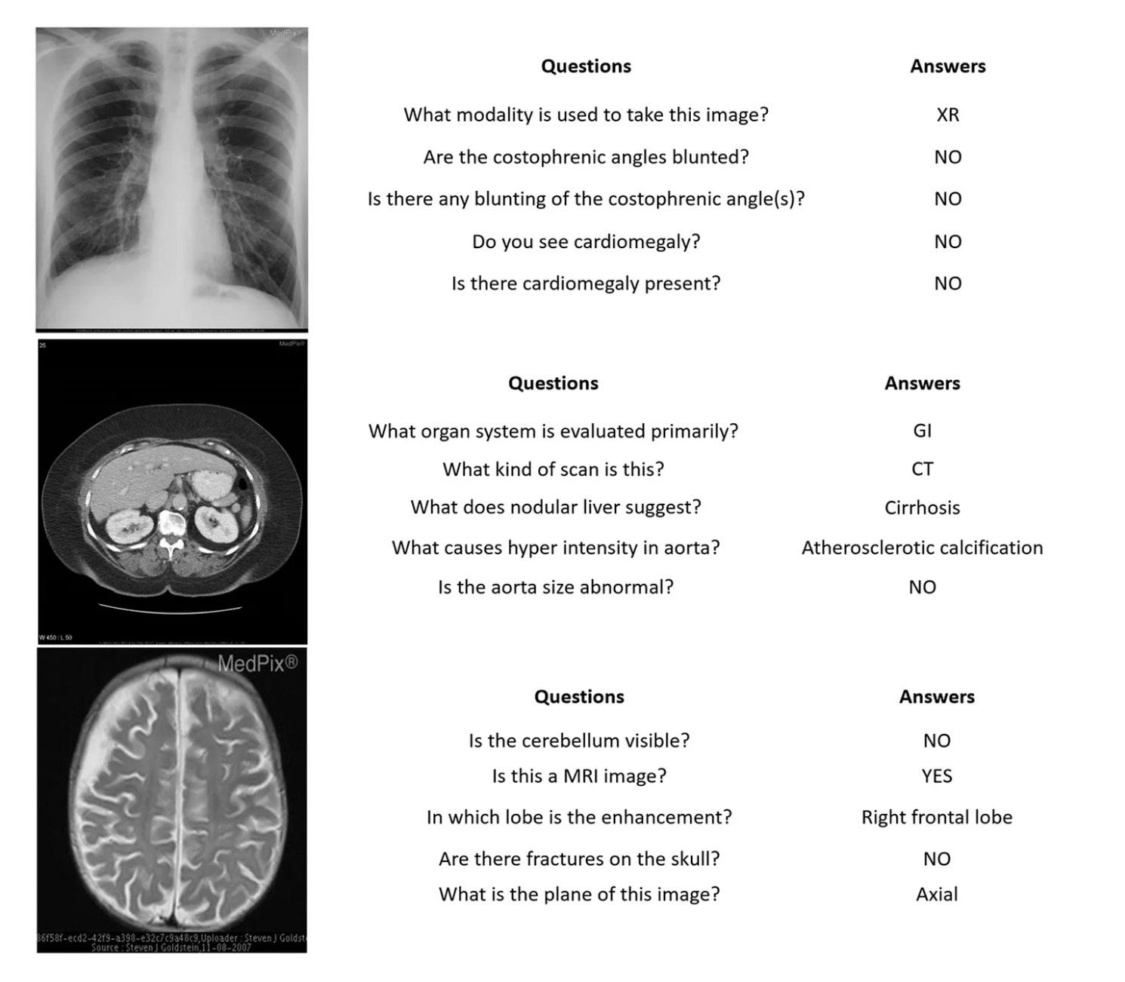
AI in Academia: Vision Language Models (VLM) in Medicine (VQA)

Slide 33
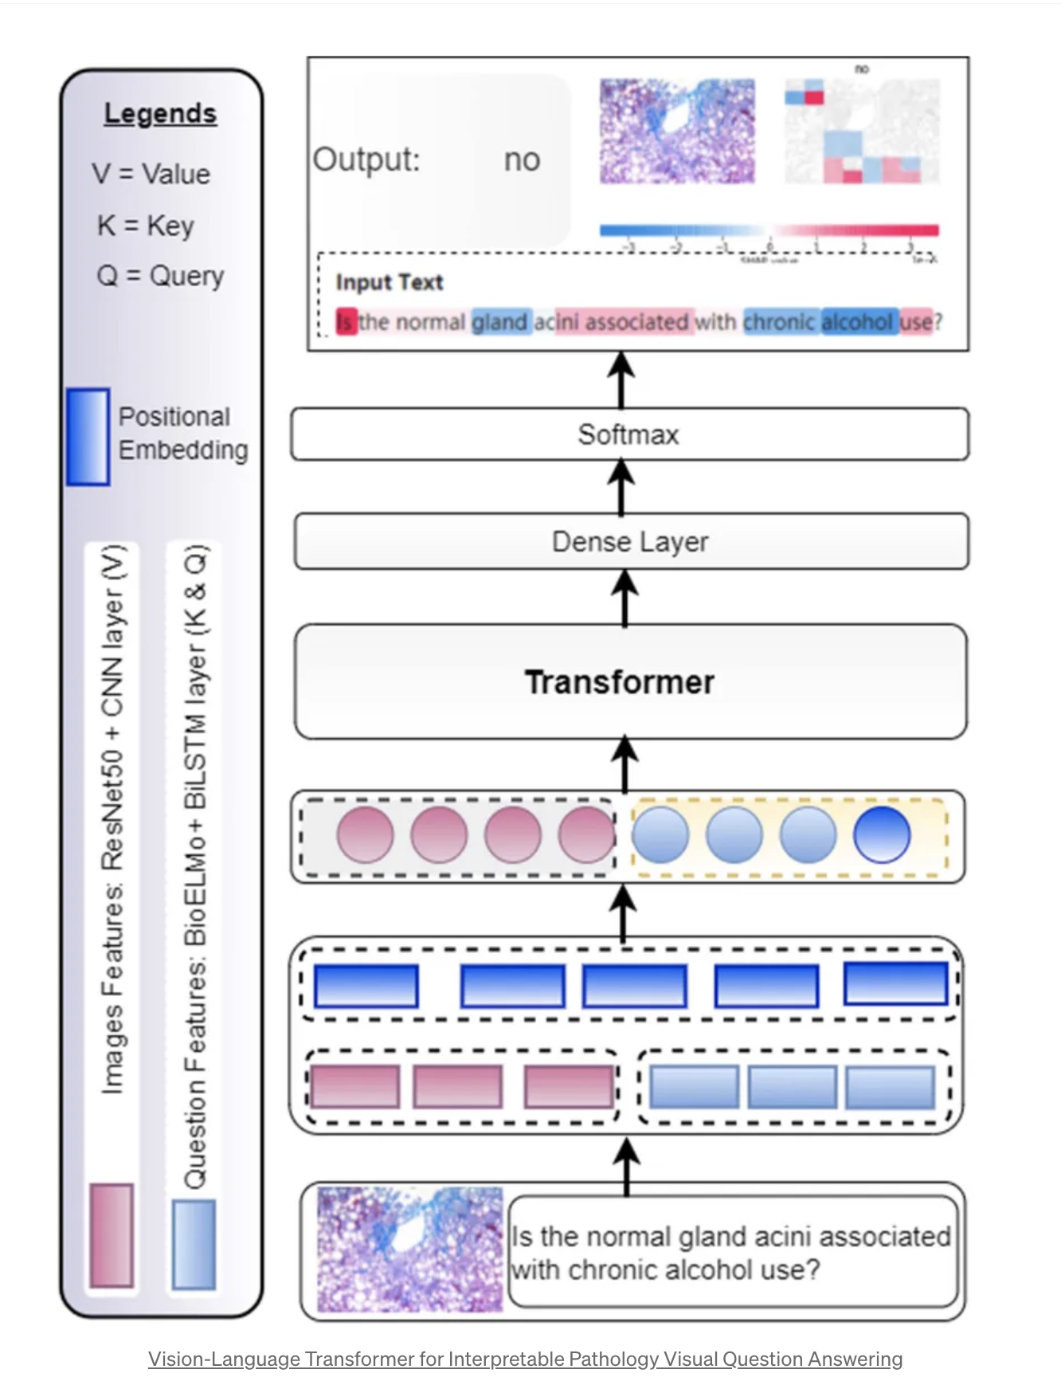
AI in Academia: Vision Language Models (VLM) in Medicine (VQA)

Slide 34
Application: Research

Slide 35
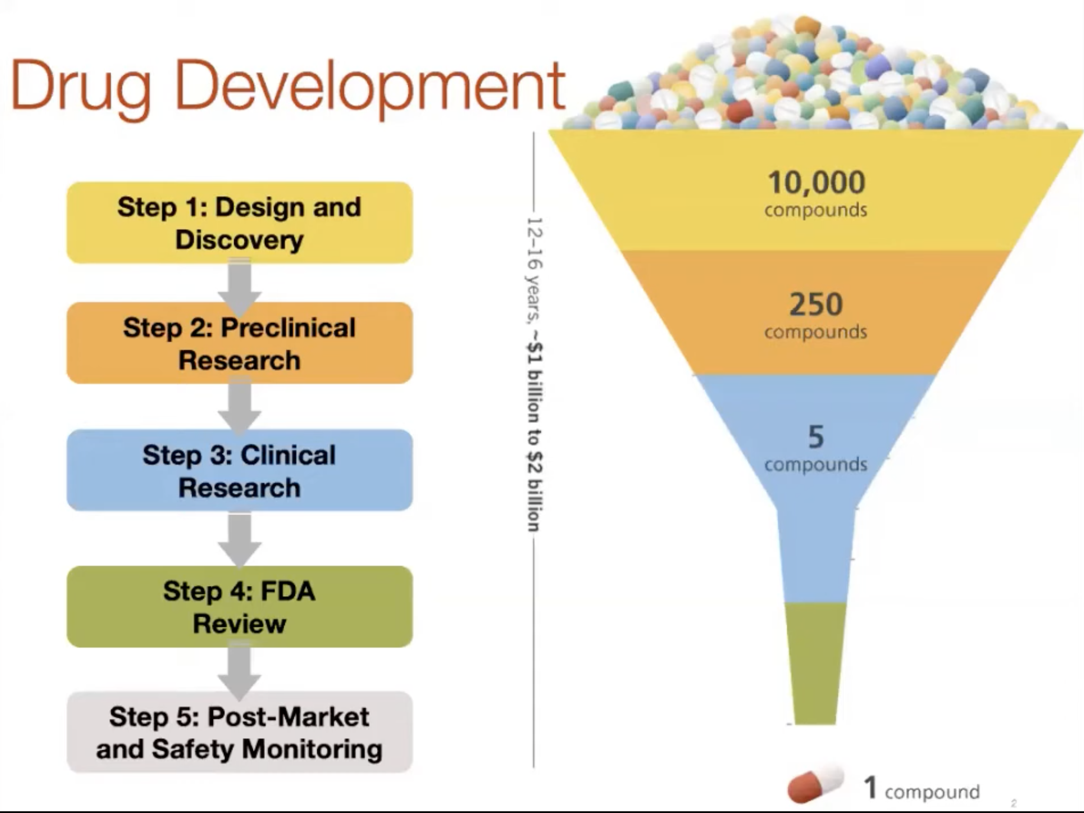
Drug Repurposing

Slide 36
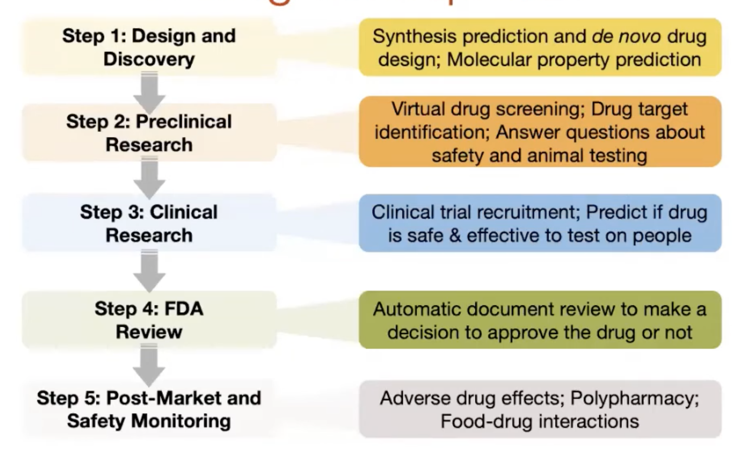
Drug Repurposing

Slide 37
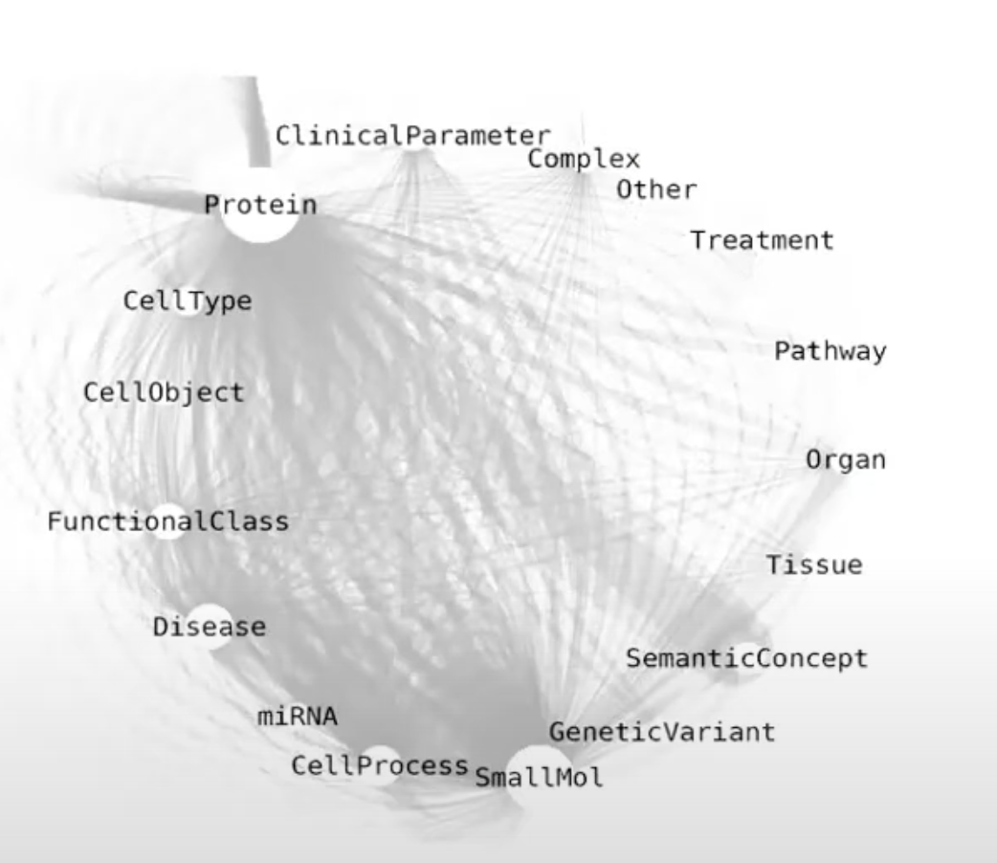
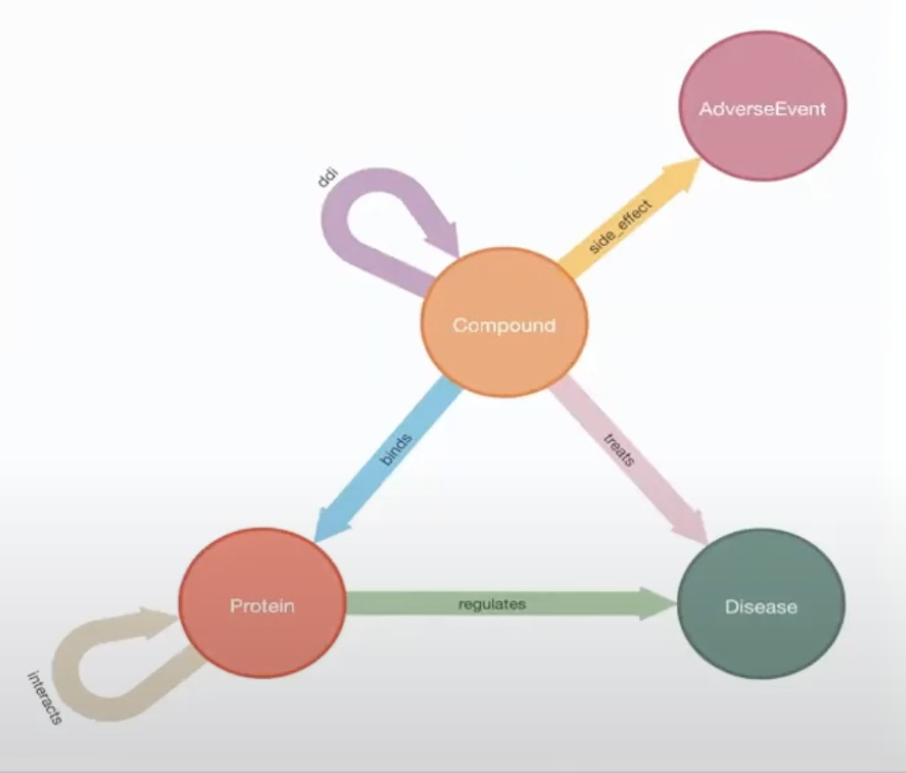
Knowledge Graph

Slide 38
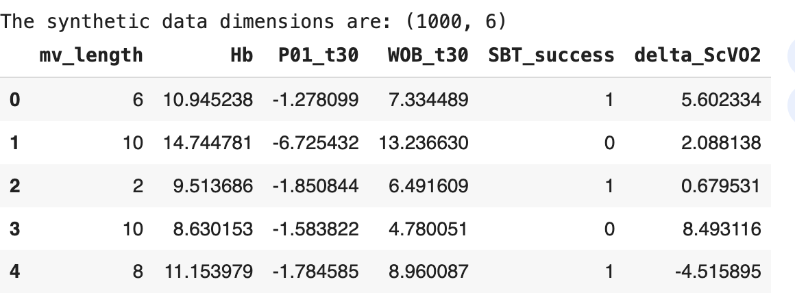
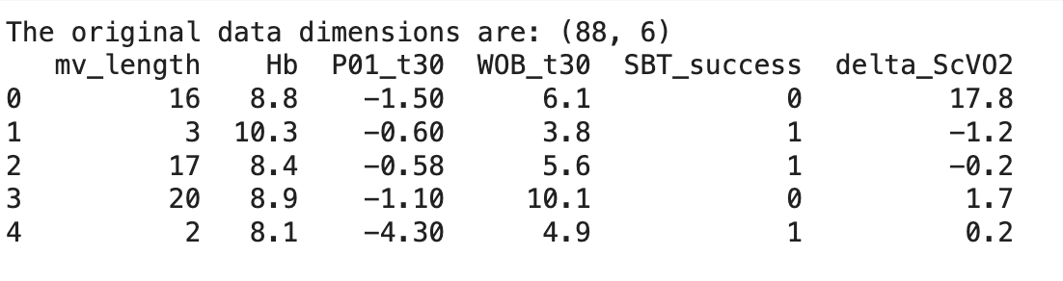
Synthetic Data: GAN for Class Imbalance

Slide 39
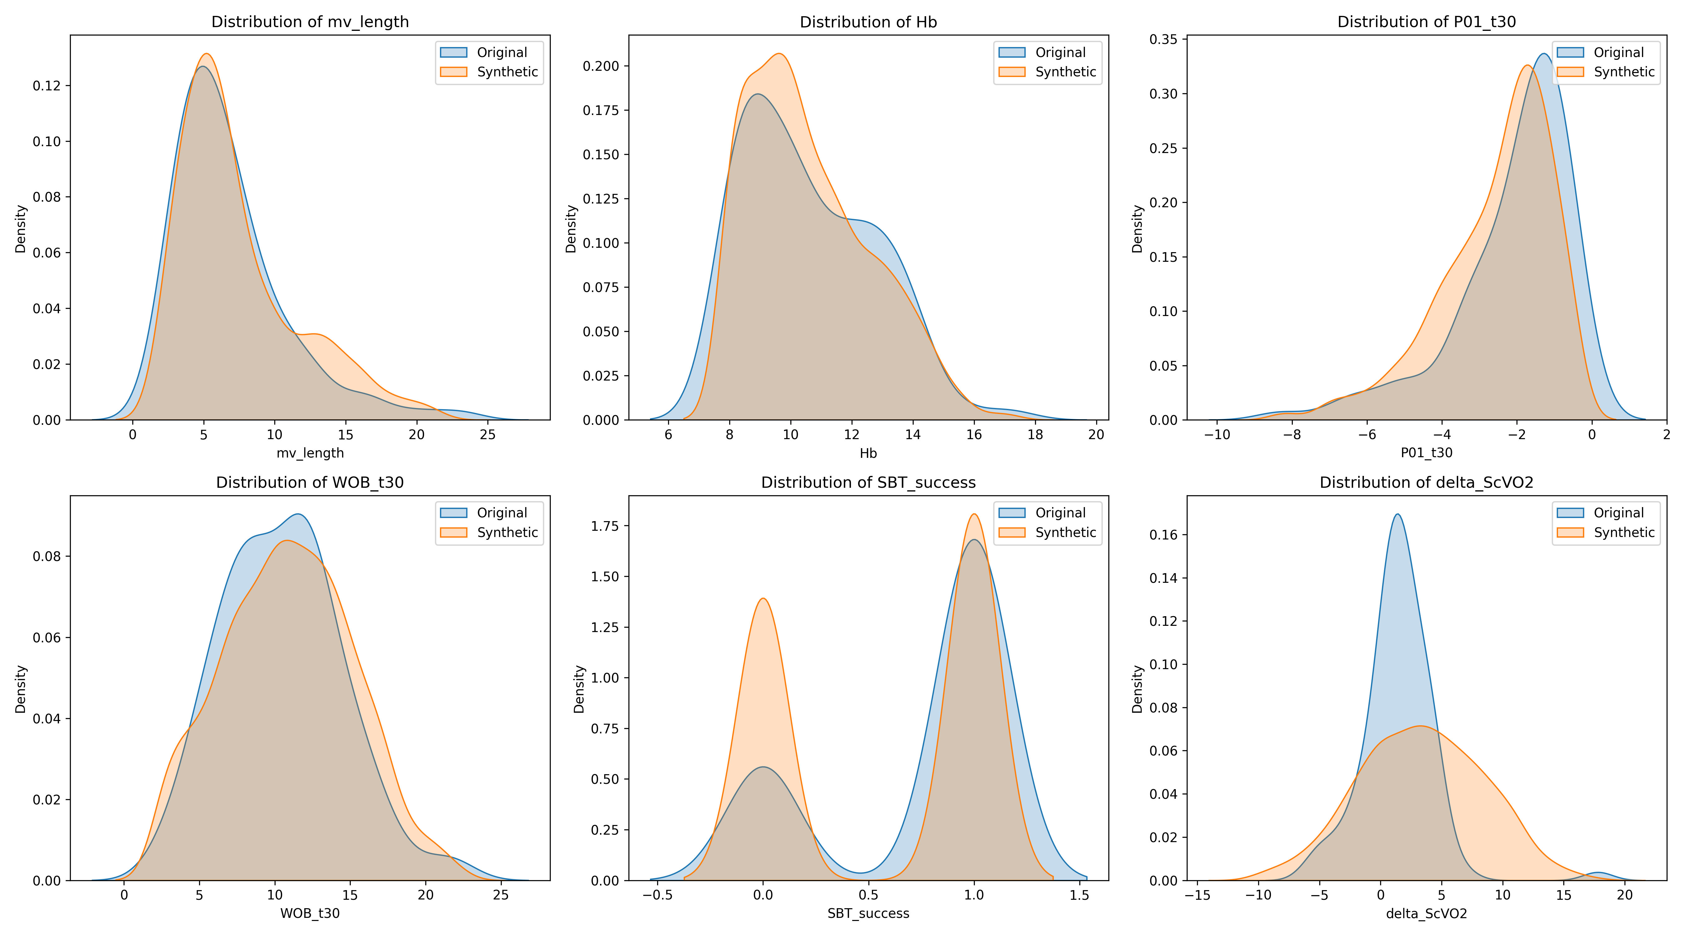

Slide 40
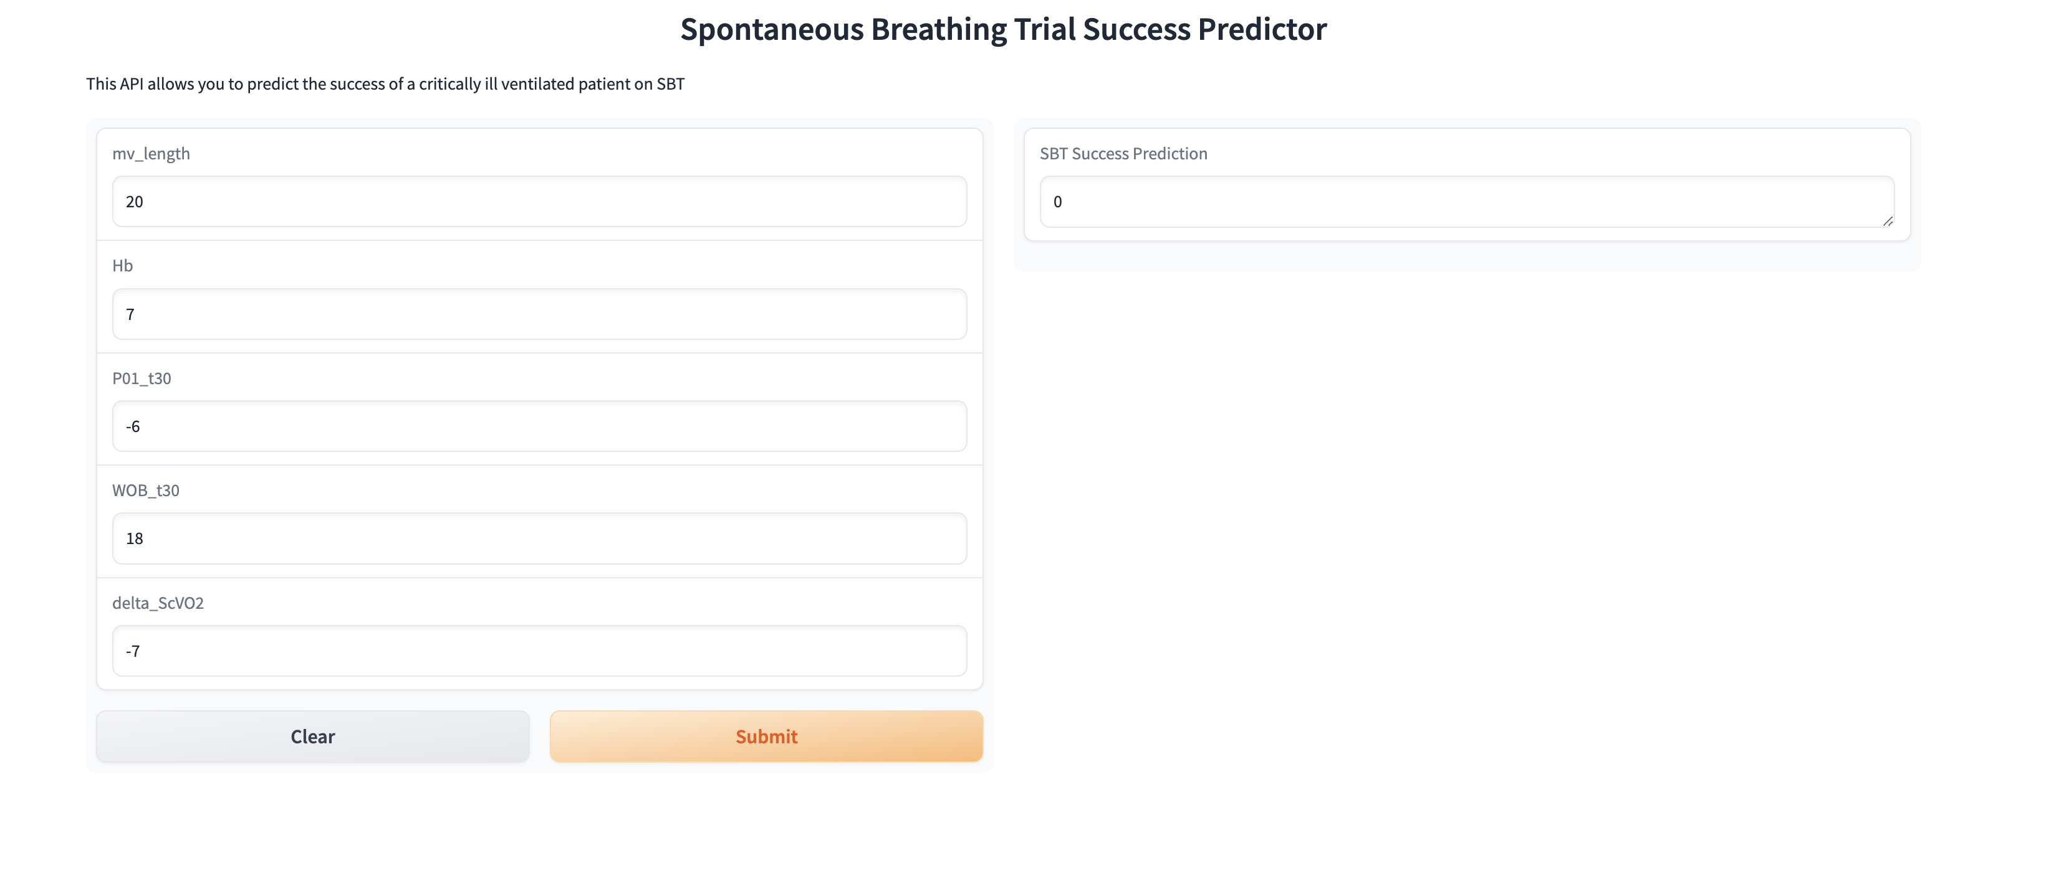

Slide 41
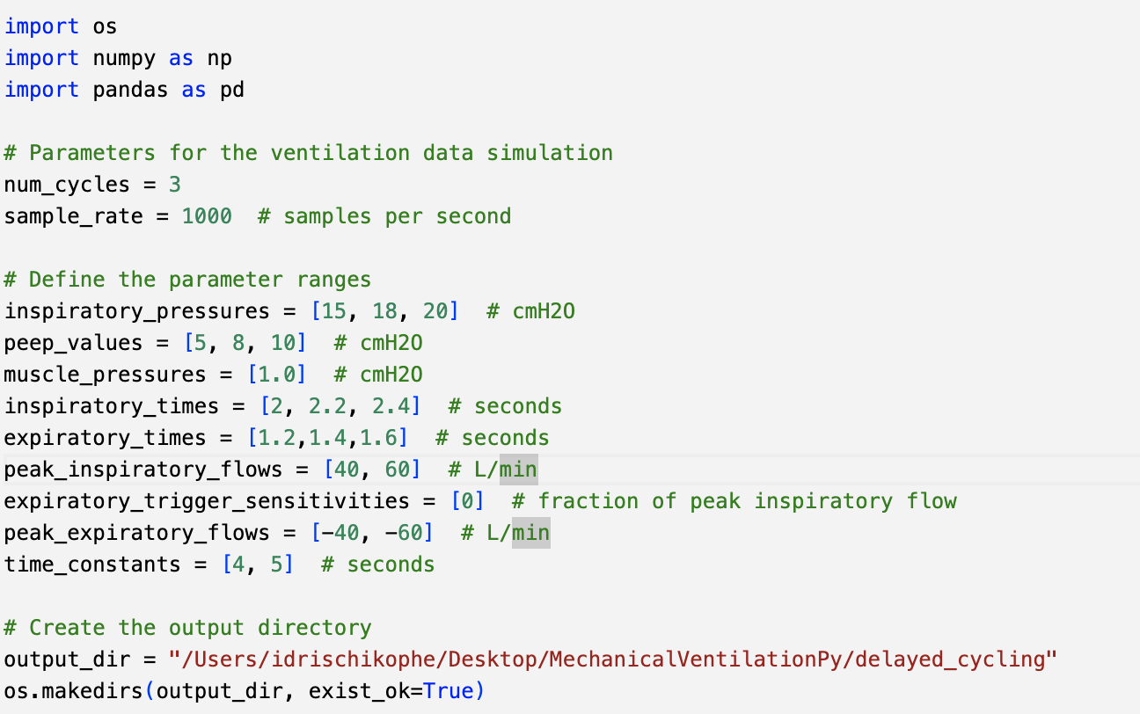
Data Simulation

Slide 42
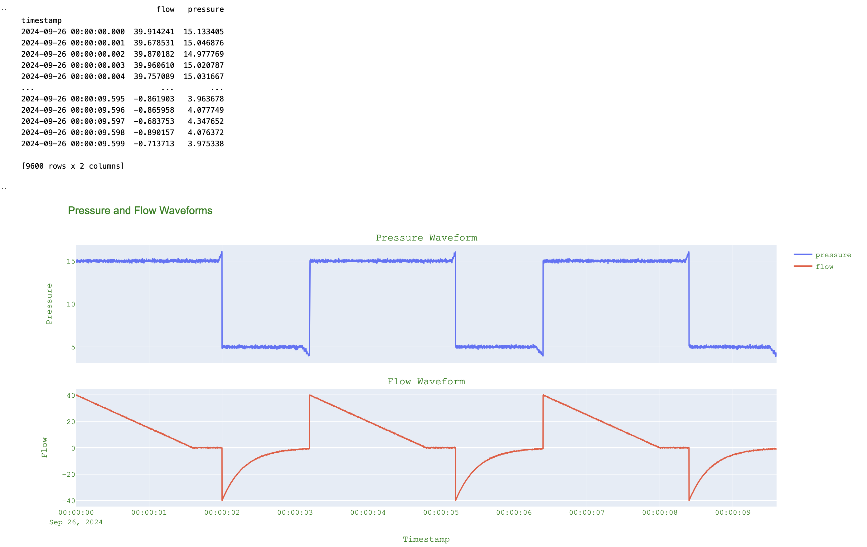

Slide 43
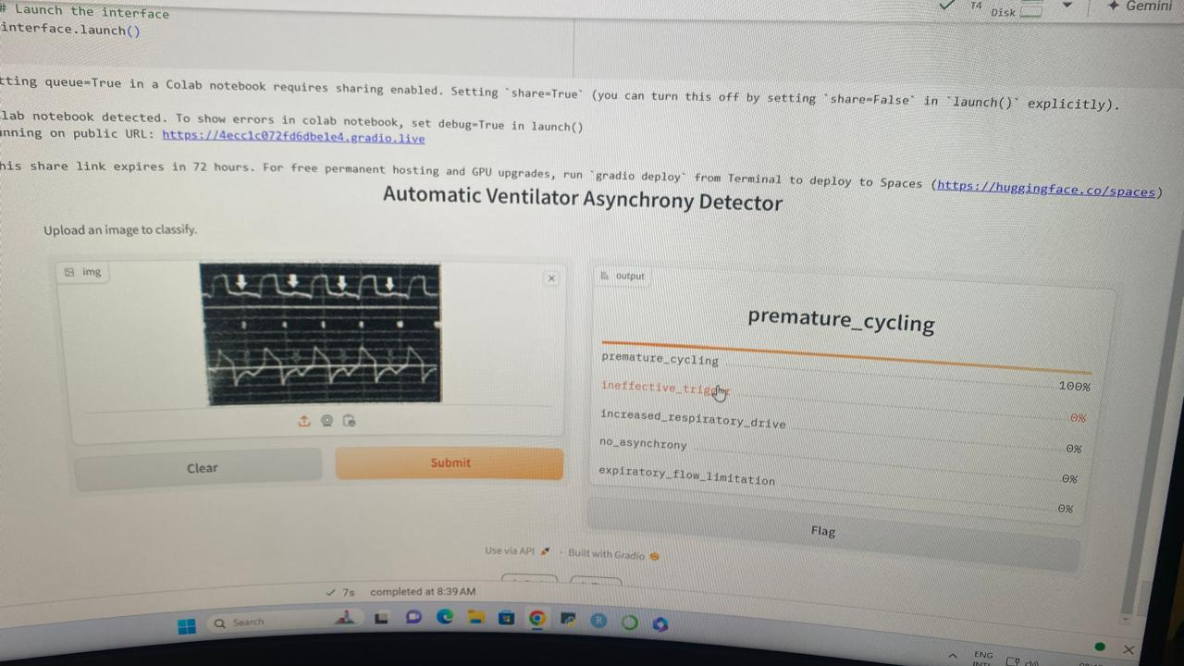

Slide 44
Application: Clinical
Triage: text data classification
Reinforcement learning

Slide 45
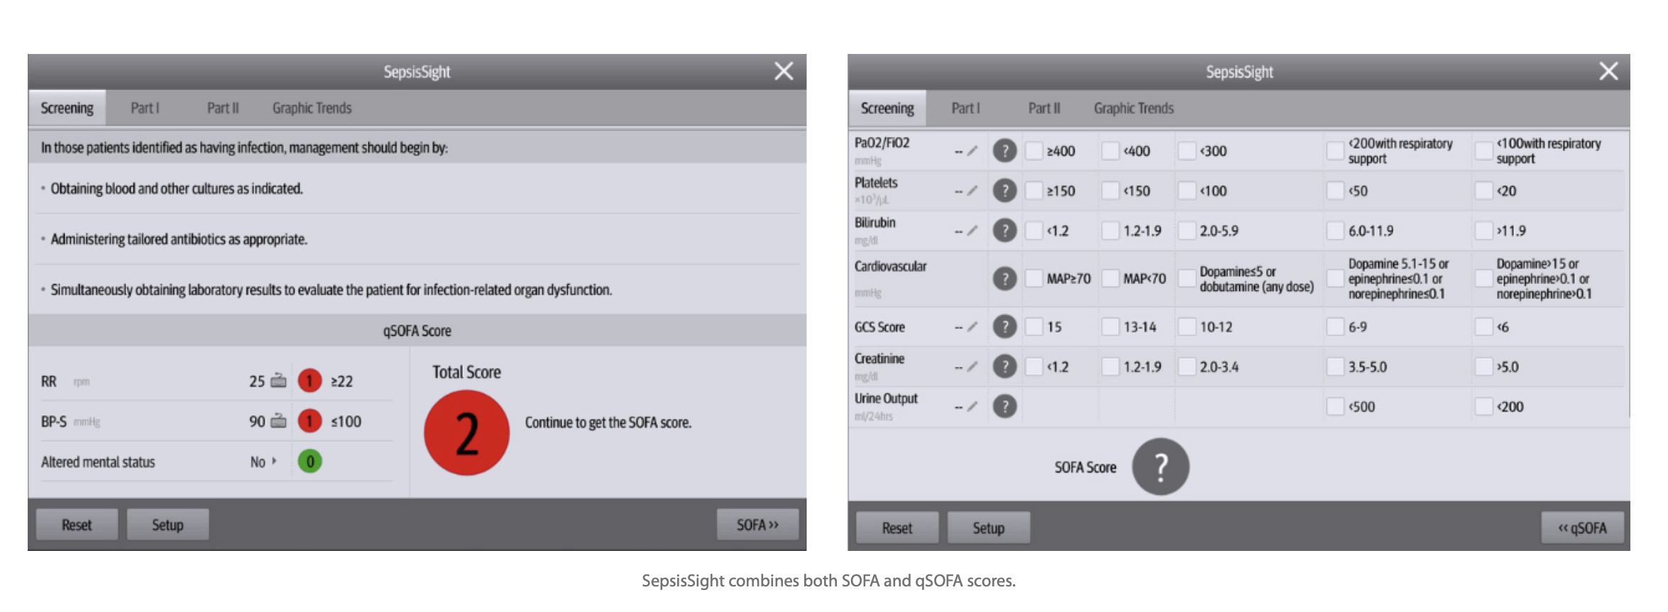
Sepsis Recognition: ER

Slide 46
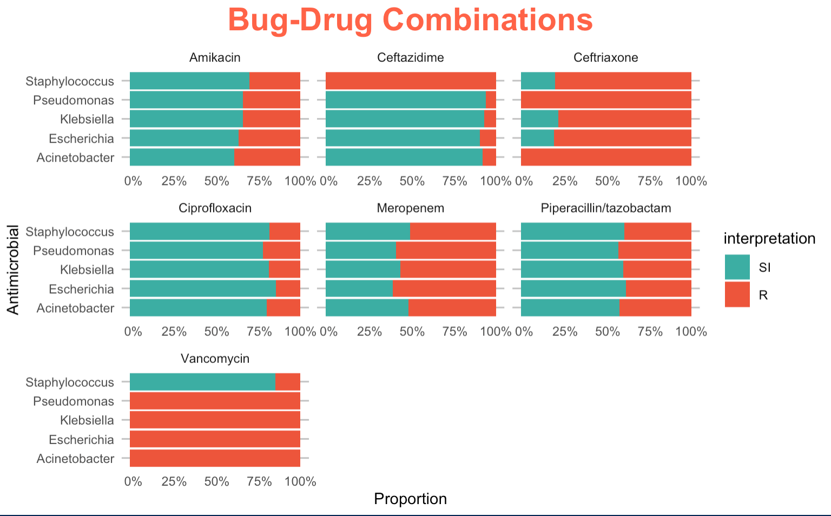

Slide 47
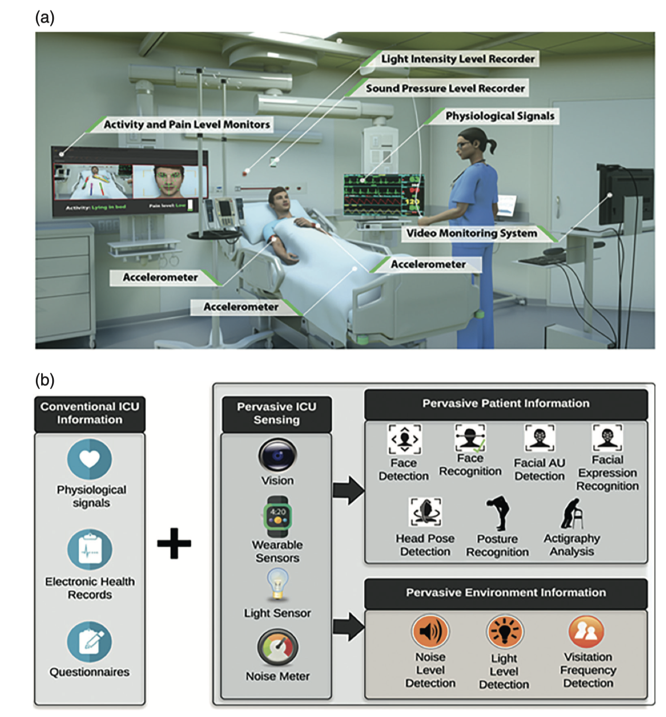

Slide 48
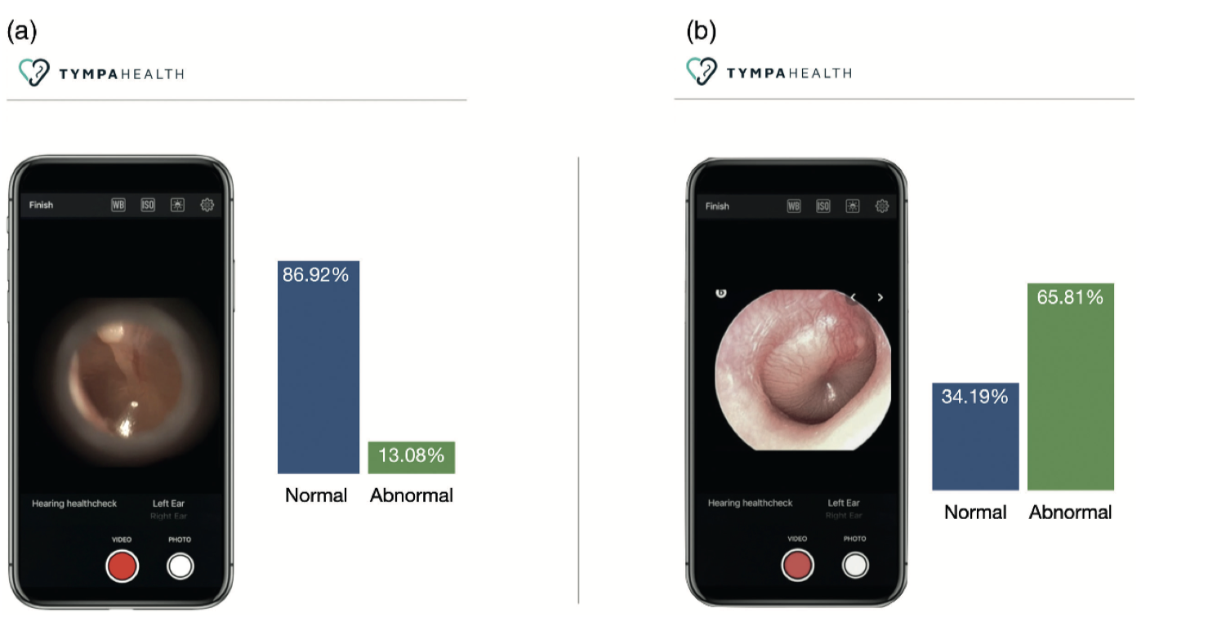

Slide 49
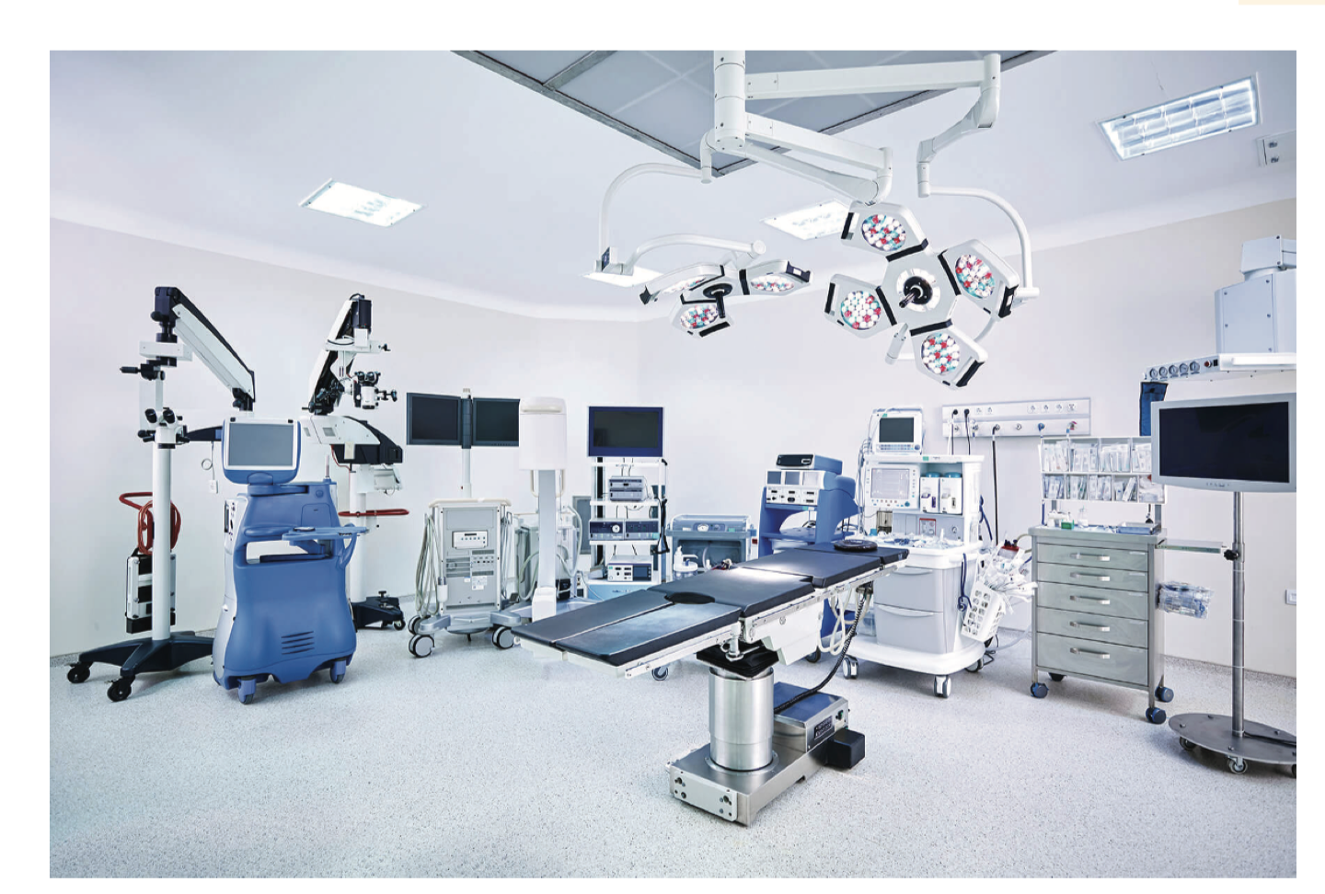

Slide 50
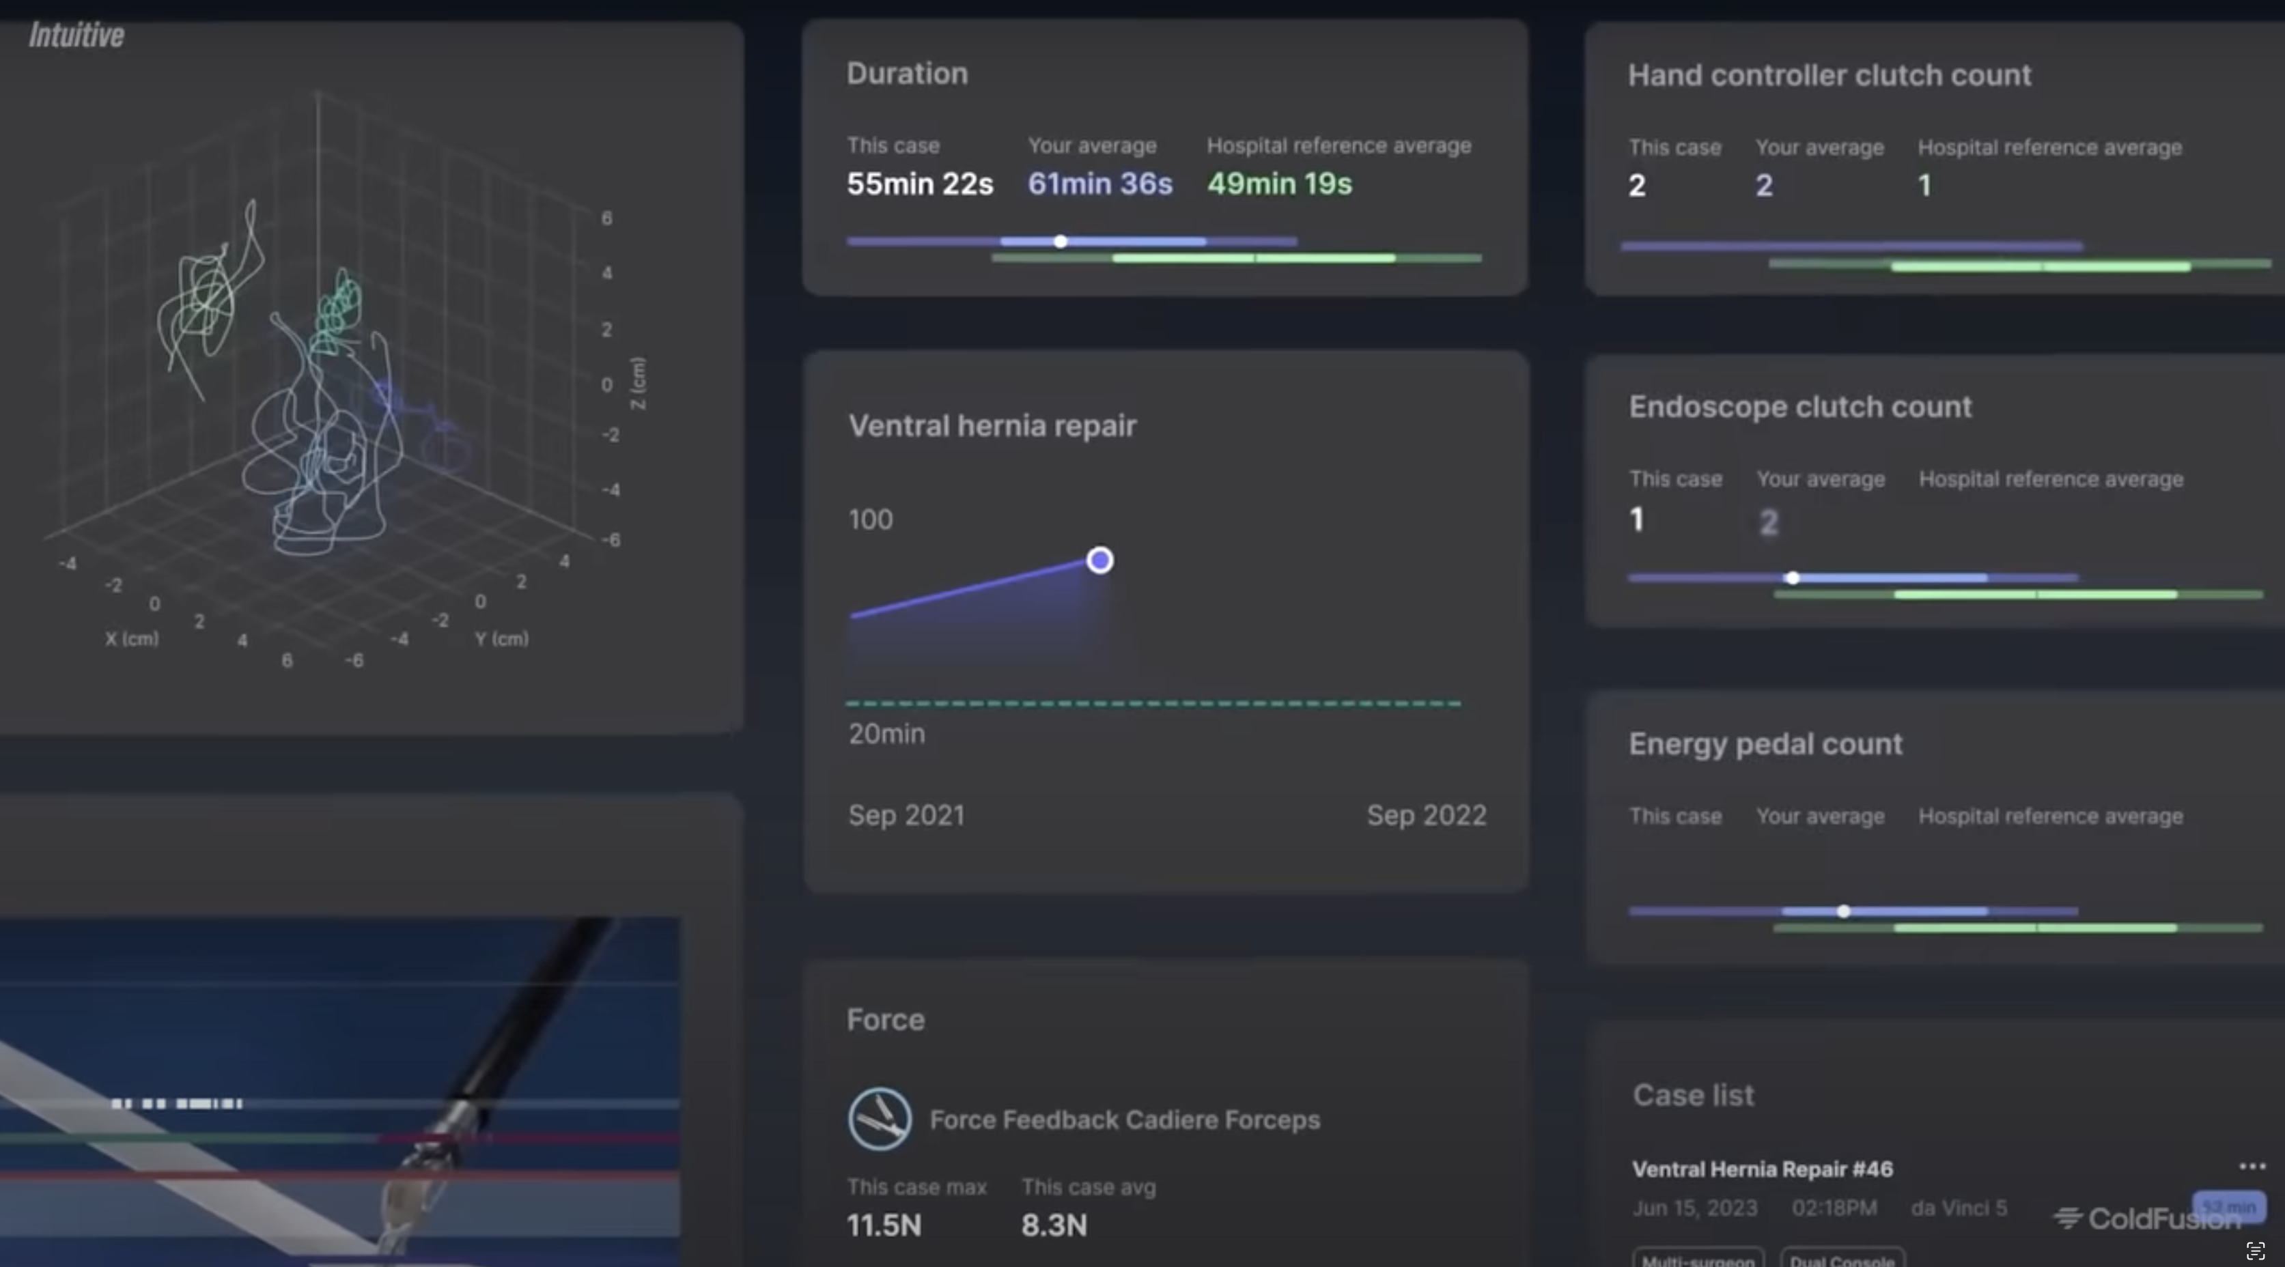

Slide 51
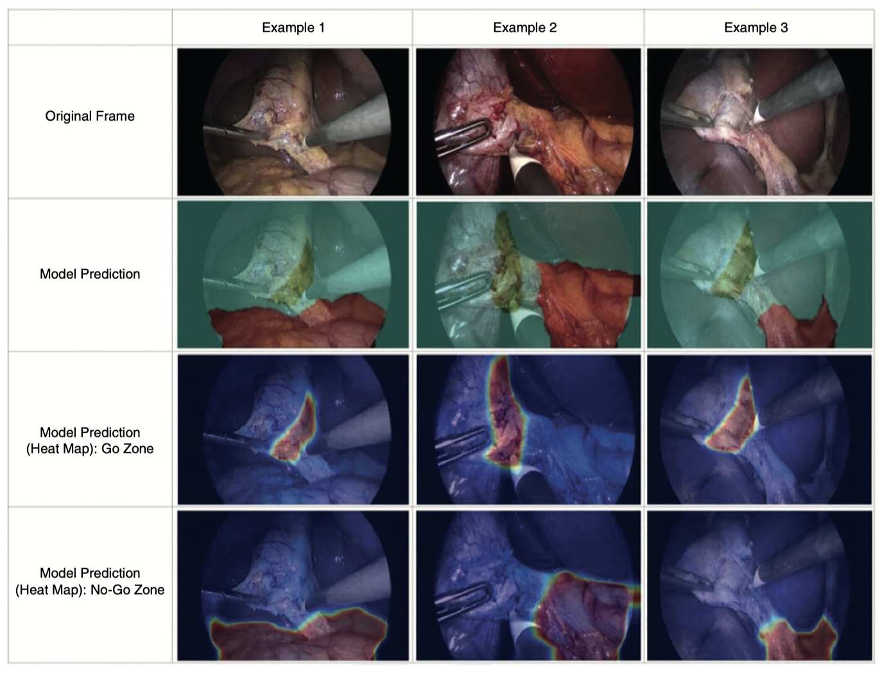

Slide 52
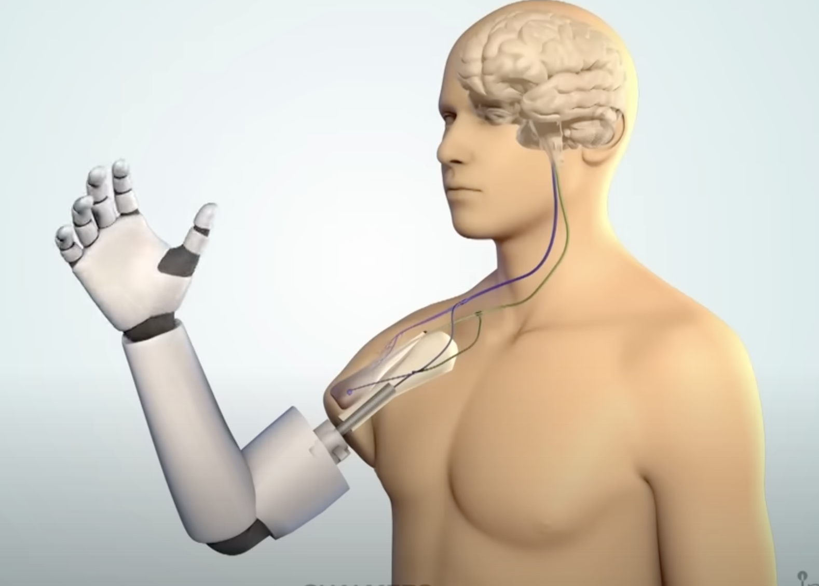
AI Powered Prosthetics

Slide 53
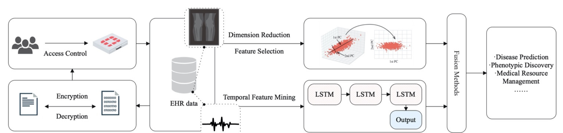
Management

Slide 54
Limitations

Slide 55


Slide 56

Data Shift

Slide 57


Black Box Effect & Explainable AI (XAI)

Slide 58


Pneumonia Detection: Selection Bias and Activation Maps

Slide 59


Slide 60
Ethics & Liability: Was the AI at Fault?
Assign ‘personhood’ to AI: let AI have malpractice-type insurance
Assign ‘common enterprise liability’: all parties share the liability
Assign ‘liability’ to AI users with responsibility for evaluating and implementing ‘black box’ AI alogrithm

Slide 61

Opportunities

Slide 62


